Slide 1
The Russian Revolution
In this lesson, students will be able to define the following terms:
Tsar Nicholas II
Duma
Bolsheviks
Vladimir Lenin
Soviet Union

Slide 2
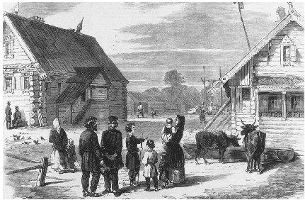
Rich vs Poor
By the early twentieth century, Russian peasants lived in poverty while landowning nobles enjoyed wealth and leisure.

Slide 3
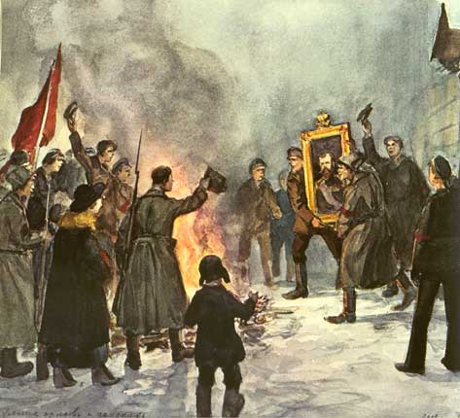
Revolution
The extreme gap between the rich and poor made Russia ripe for revolution.
In 1905, revolutions broke out across Russia.

Slide 4
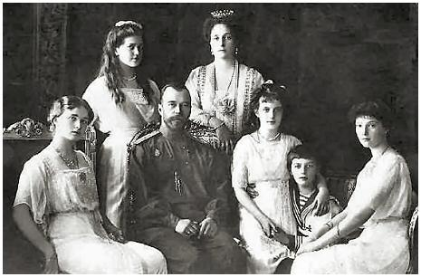
CZAR NICHOLAS II
Tsar Nicholas II tried to stop the unrest. He granted limited reforms, including
the creation of a new legislative assembly known as the Duma. Peasants
were even allowed to buy village lands.

Slide 5
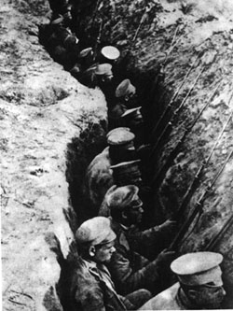
The Russian economy
showed signs of
improvement, but the First World War hurt the Russian economy. In 1914, Tsar Nicholas declared war against Germany. One-third
of all Russian men
were forced into the
army.

Slide 6
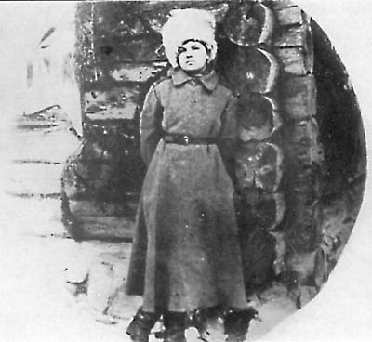
Fall of the Russian Soldier
Russian soldiers suffered disastrous defeats. They were poorly trained and badly equipped. Many deserted.
Russian factories could not produce enough weapons or food.

Slide 7
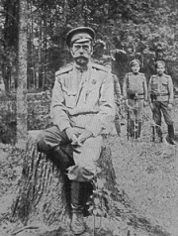
In 1917, German
troops cut Russian
railroad lines,
preventing food from
reaching Russian
cities and soldiers.
Strikes broke out
across Russia. The
Tsar was forced to
abdicate or give up
his throne.

Slide 8
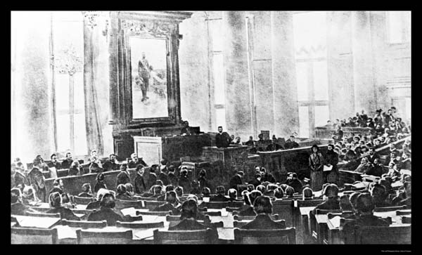
Russia becomes a Republic
The leaders of the Duma declared Russia a Republic in 1917 and centuries of Tsarist rule came to an end. The Duma established a provisional government but it lacked support because it refused to end the war.

Slide 9
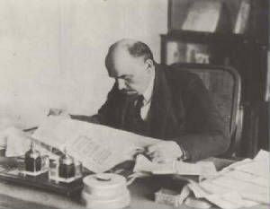
PEACE LAND BREAD
The Bolsheviks, a revolutionary group following the ideas of Karl Marx, promised “Peace, Bread, and Land”. They were led by Vladimir Lenin and seized power in November 1917.

Slide 10
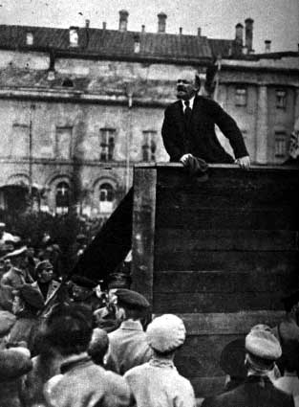
Soon after taking
power, the Bolsheviks
changed their name
to “Communists”. They also changed the name of the Russian empire to the Union of Soviet Socialist Republics (U.S.S.R.) or Soviet Union. Russia was the
first Communist nation.

Slide 11
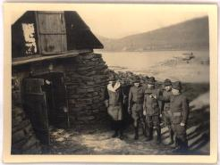
CIVIL WAR
A civil war broke out across Russia. The Communists eventually won
the civil war.

Slide 12
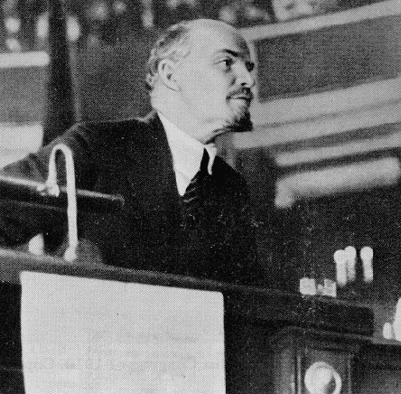
LENIN
Once in power, Lenin withdrew from World War I and introduced a series
of domestic changes.

Slide 13
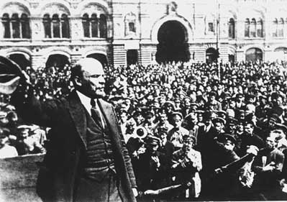
Lenin transferred land to poorer peasants
while many factory workers were organized
to control and operate factories. All
industries were nationalized or taken
over by the government.

Slide 14
Questions for Reflection:
What problems confronted Nicholas II?
Why was the Duma established?
How did the First World War harm Russia?
Who were the Bolsheviks and what did they promise the Russian people?
Who was Vladimir Lenin and what did he do?
Why do you think a civil war erupted in Russia after Lenin seized power?

