Slide 1
The Greek City-States
In this lesson, students will identify characteristics of the Greek city-states.
Students will be able to identify and/ or define the following terms:
Polis
Golden Age
Democracy
Helots
Persian Wars

Slide 2
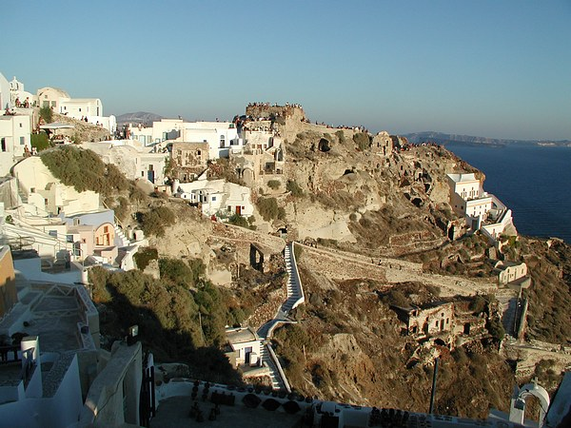
Geography
It is important to remember that mountains
separated the Greek city-states.

Slide 3
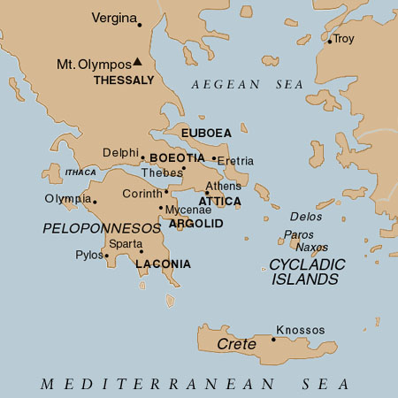
The Polis
Political
Shared a common language & religion,
never had a unified system of government.
The Greeks lived in independent city-states.

Slide 4
political

Slide 5
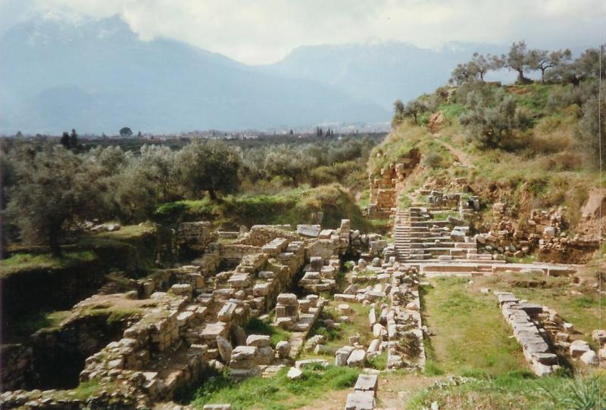
Sparta was another important Greek
polis.
Social

Slide 6
Sparta
social
Sparta was a militaristic polis.
In Sparta, all men had to serve in the military.
Weak or disabled babies were left to die.

Slide 7
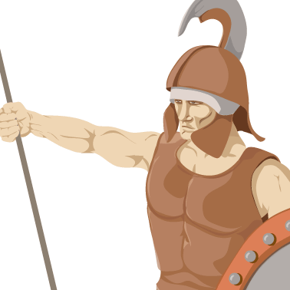
Culture / Political
A Spartan’s life revolved around the
military. A Spartan man was a soldier
for most of his life.

Slide 8
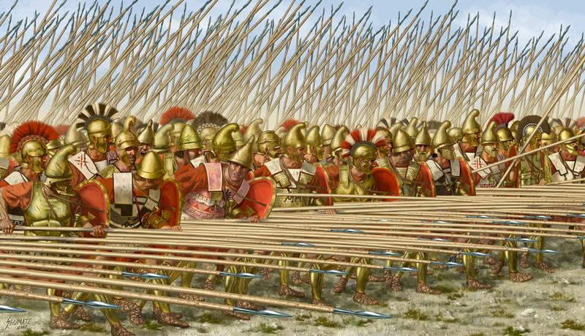
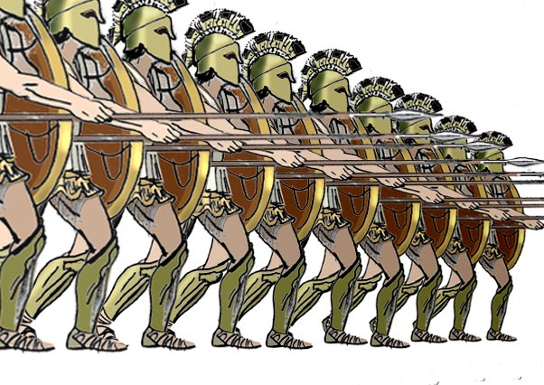
Phalanx
http://www.youtube.com/watch?v=McwmRQUTfKk
Citizens were expected to defend the polis
Foot soldiers stood side by side, holding a spear in one hand, and a shield in another
Fearsome formation called phalanx, was most powerful fighting force in ancient world
political

Slide 9
Helots
social
The Spartans had helots or slaves.
The helots farmed for the Spartans.
While the helots farmed, the Spartans focused on military affairs.
Life in Sparta differed greatly from life in Athens.

Slide 10
Athens
Athens was an important polis in ancient Greece.
The people of Athens developed democracy.
Democracy is a system of government where citizens vote or participate in government.
Social / Political

Slide 11
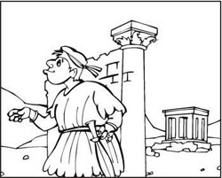
Social/ political
In Athenian democracy, only free men
born in Athens could vote. Women,
slaves, and foreigners could not vote.

Slide 12
Reforms
Political
Common people opposed wealthy and Tyrants running the gov.
Demanded a written code of laws
Draco, a Greek lawmaker, drafted the first code : mainly about contracts and property ownership

Slide 13
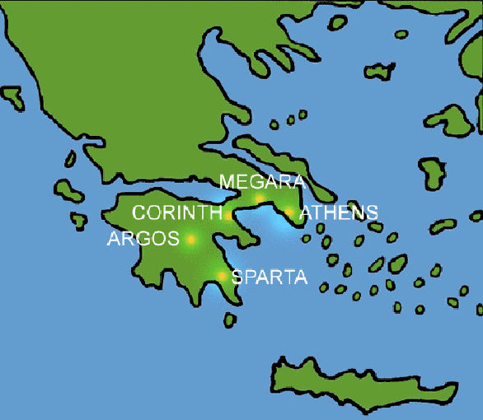
The Golden Age of Athens
A golden age is a time of peace, prosperity, and great achievements.
The Athenians produced great works of literature, philosophy, and art.
S.P.A
Cultural

Slide 14
Questions for Reflection:
What was a polis and why did the Greeks develop the polis?
Define a golden age and name a Greek polis that experienced a golden age.
List three differences between the ancient Greek polis of Athens and Sparta.
Who were the helots and how were they treated?
Describe Athenian democracy.

Slide 15
Review: Danger of helot revolt= Sparta becoming a military state
Review: Danger of civil war= Athens creates a democracy
Greatest danger of all- invasion of Persian armies
Persian wars- wars between Greece and Persian empire

Slide 16
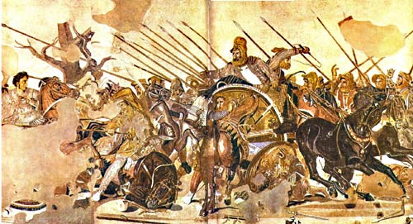
The Persians had built a vast empire.

Slide 17
The Persians and the Greeks
In 519 B.C., the Persians conquered a group of people called the Ionian Greeks who lived in Asia Minor.
The Ionian Greeks asked the mainland Greeks for help.
The Greeks did help and the Persian king was furious.

Slide 18
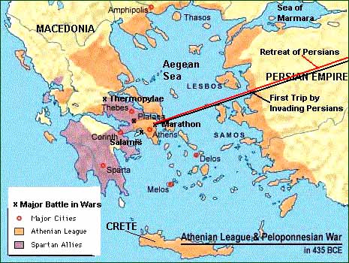
The Persians invaded the Greeks.

Slide 19
Option 1 : Video –
Option 2- Slide by slide recap -
http://www.youtube.com/watch?v=cPUo7b-QVjo

Slide 20
The Persian Wars
The Persian army outnumbered the Athenian army.
However, the smaller Greek ships could move easily in the water. The Greek ships destroyed the Persian ships.
Many Greek city-states also united to defeat the Persians.

Slide 21
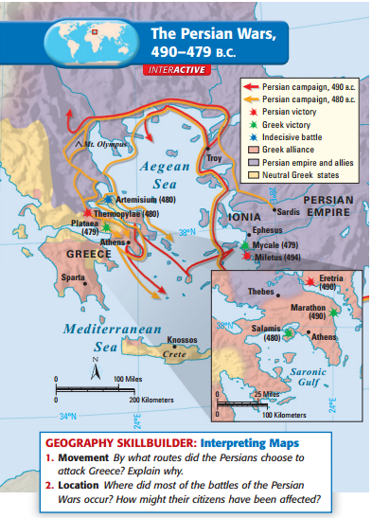

Slide 22
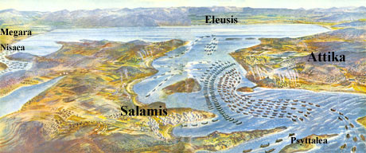
Look at the map! Can you see why the
smaller Greek ships had an advantage?

Slide 23
The Alliance
After the Persian Wars, the Greek city-states united.
Each city-state agreed to give money or ships to be used to defend all of them. Athens led the alliance. The alliance was called the Delian League.
However, Athens used the alliance money to rebuild Athens.

Slide 24
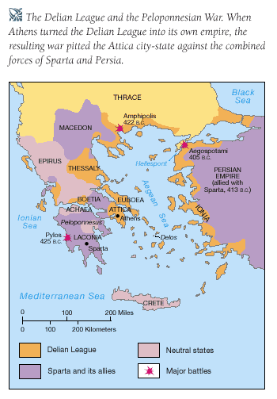

Slide 25
The Peloponnesian War
Athens betrayed the trust of the alliance.
The other Greek city-states declared war on Athens.
This war was called the Peloponnesian War.

Slide 26
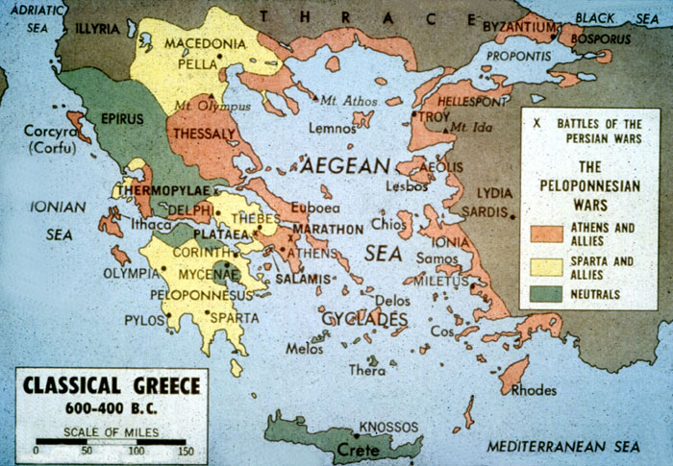

Slide 27
Summation of Wars
The Persian Wars strengthened the Greek city-states.
However, the Peloponnesian War weakened the Greek city-states.
Sparta led the alliance against Athens.

Slide 28
Questions for Reflection:
Why did the Persians invade Greece?
Why did the Persian Wars strengthen the Greeks?
Define the Delian League.
Why did the Peloponnesian War begin?
Why did the Peloponnesian War weaken the Greeks?

