Slide 1
The Persian Empire
In this lesson, students will identify characteristics of the Persian Empire.
Students will be able to define and/of identify the following terms:
Empire / Persians
Provinces/ Satrap
Royal Road
Zoroastrianism/ Zoroaster

Slide 2
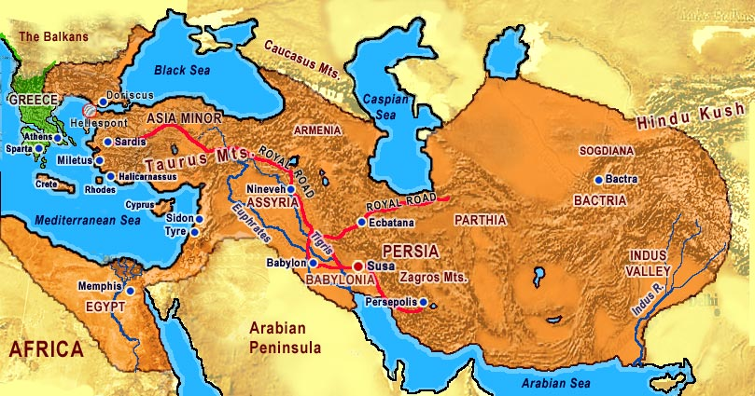
The Persians built a vast empire.

Slide 3
What is an Empire?
An empire is a state that rules over several different cultures.
The Persians were early empire builders.
They conquered neighboring cultures.
The Persians lived in present-day Iran.

Slide 4
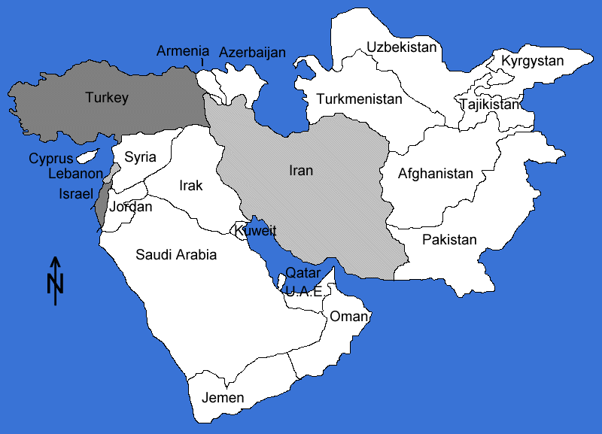
Iran is a country in Southwest Asia.
Southwest Asia is called the Middle East.

Slide 5
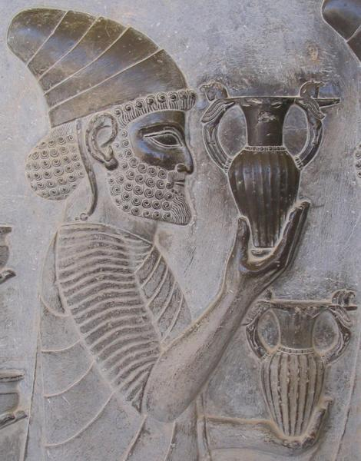
Social
Honored local customs and religions
Honored all in their empire but Satraps rule provinces
Speak various languages
Strong Military
Conquered people like leadership of
Cyrus & Darius.

Slide 6
Political : Leaders
Cyrus ( 2,3 ) – fair to those he took over; honored local customs; wisdom and kindness
Cambyses – conquered Egypt & destroyed a lot; people did not like very much
Darius ( 5,6) – Ten Thousand Immortals; efficient and well organized administration; took over areas east up to India; divided empire into 20 provinces

Slide 7
Ruling a Vast Empire : Political
(4) At the height of the Persian Empire, the Persians ruled a territory that stretched from the Nile River to the Indus River.
(5) To rule such a vast empire, the Persians divided their empire into provinces.
Satrap(6) Each province was ruled by a local official loyal to the Persians.

Slide 8
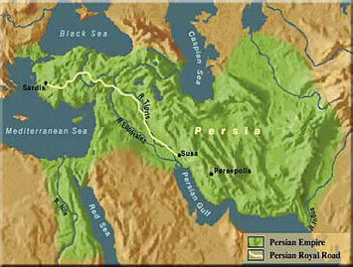
Economics
The Persians built roads to connect their
vast empire. Trade Routes / Relay Stations

Slide 9
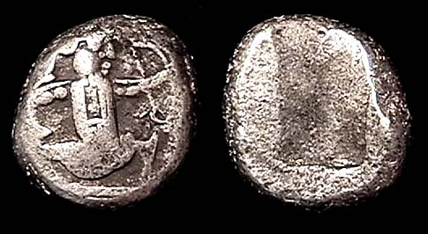
Persian
Coins
Standard
Money
Promotes
Trade
Economic
Tribute/ Taxes were a payment
from one ruler to another ruler.
Paying Tribute/ Tax a way
to acknowledge the superior ruler.

Slide 10
Zoroastrianism : Culture
(7,8,9) The Persians were polytheistic until Zoroaster started a new religion in about 600 B.C.
(10) Zoroaster taught that there were two forces in the world: a force of good - Light and a force of evil - Dark.
(11,12) People were free to choose which force to follow but they would be rewarded or punished in the afterlife.

Slide 11
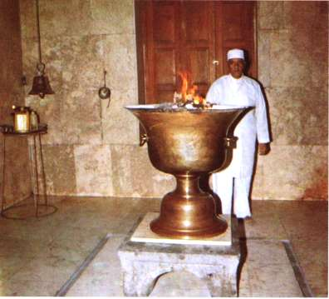
Zoroastrians believe that fire is a symbol
of their God.

Slide 12
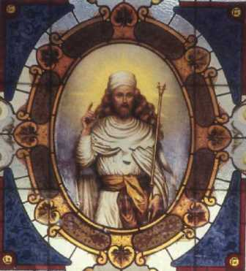
Cult of Milthra
Respected other cultures
Specific dress for warriors
Zoroaster taught that the world is
a battle between the God of good,
Ahura Mazda, and the force of evil.

Slide 13
Questions for Reflection/ Processing:
Define empire.
Where did the Persians live?
What lands were conquered by the Persians?
Why did the Persians build roads?
Why did the Persians divide their empire into provinces?
What do Zoroastrians believe?

