Slide 1
Economic Revolutions Vocabulary

Slide 2
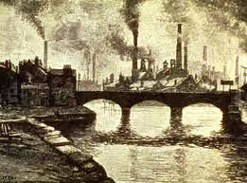
Industrialization
The development of industries for the machine production of goods, like factories.

Slide 3
Laissez Faire Policy
The idea that government should not interfere with or regulate industries and businesses.

Slide 4
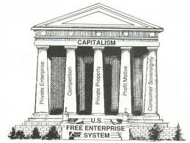
Free Enterprise
An economic system where few restrictions are placed on business activities and ownership.

Slide 5
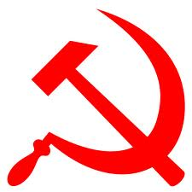
Communism
An economic system where all means of production are owned by the people, private property does not exist, and all goods and services are shared equally.

Slide 6
Socialism
An economic system where the factors of production are owned by the public and operate for the welfare of all.
Government
The People

Slide 7
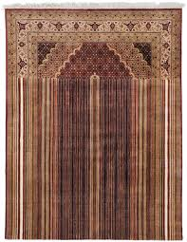
Textile
A cloth that is a flexible woven material consisting of a network of natural or artificial fibers referred to as thread or yarn.

Slide 8
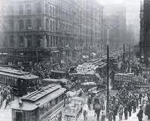
Urbanization
The growth of cities and the migration of people who move to them.

Slide 9
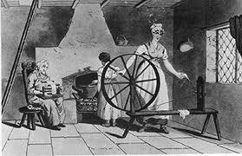
Cottage System
The manufacturing of goods made by people working individually in their homes.

Slide 10
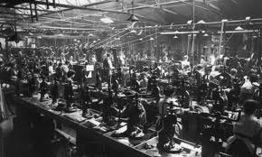
Factory System
The manufacturing of goods in a large building in which machinery is used to make the finished product.

Slide 11
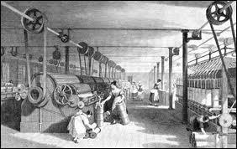
Textile Mills
A manufacturing facility in which raw materials are turned into thread, cloth is woven, and fabric is dyed.

Slide 12
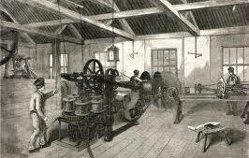
Manufacture
The production of goods for use or sale using labor, tools, machines or a combination of all three.

Slide 13
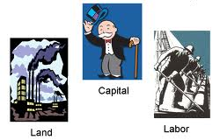
Factors of Production
The resources- including land, labor and capital- that are needed to produce goods and services.

Slide 14
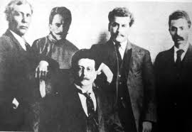
Middle Class
A social class made up of skilled workers, professionals, business people, and wealthy farmers.

Slide 15
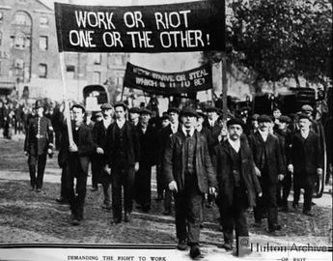
Unions
An association of workers, formed to bargain for better working conditions and higher wages.

