Slide 1
The Han Dynasty
In this lesson, students will be able identify significant characteristics of the Han dynasty.
Students will be able to identify and/or define the following terms:
The Han Dynasty
Civil Service Examination
Silk Road
Cultural Diffusion

Slide 2
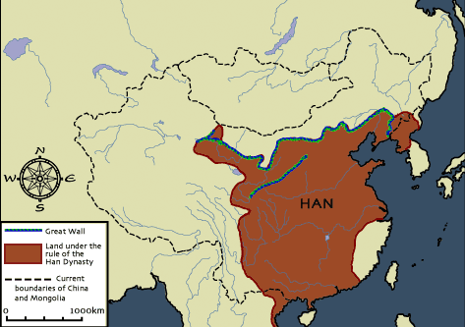
The Han dynasty was an important Chinese
dynasty.

Slide 3
Han Come to power mandate of Heaven
(206 B.C. to 220 A.D.)
Founded after the Qin dynasty by Liu Bang, a man born to a peasant family and king of the state of Han
Political

Slide 4
Golden Age of the Han
Political
During the Han dynasty, China experienced a period of
peace, stability, and prosperity
Frequently compared to the Roman Empire

Slide 5
Political
Shifted away from the Legalist philosophy of the Qin dynasty
Han developed a bureaucracy
A Confucian system of government was instituted.

Slide 6
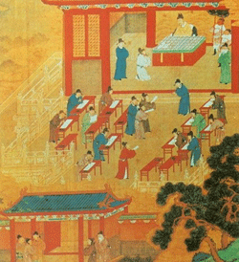
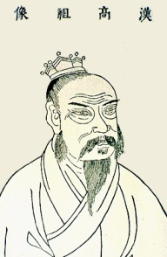
- Civil Service System favored the wealthy who could afford years of education required to pass the exams.
Liu Bang
Civil Service Exams

Slide 7
Government Officials
officials were selected based on merit, rather than birth. ( Civil Service Exam)
Tested on knowledge of history & Confucian philosophy.
Scholars who proved their knowledge were appointed government officials
Enforced Han laws
Collected taxes.

Slide 8
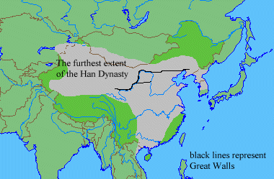
Han emperors expanded China’s borders
and increased trade.

Slide 9
International Trade
The Han established overland trade routes
The Silk Road, which connected China to the Roman Empire and other regions.
Merchants carried goods by camel caravan along this route through mountains, steppes, and deserts.

Slide 10
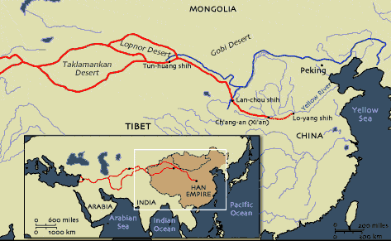
The Silk Road was a famous Chinese
trading route.

Slide 11
Economic
Trading silk, bronze, iron, and spices,
Silks were China's most valuable export commodity, and bolts of silk were used as currency and given as state gifts.

Slide 12
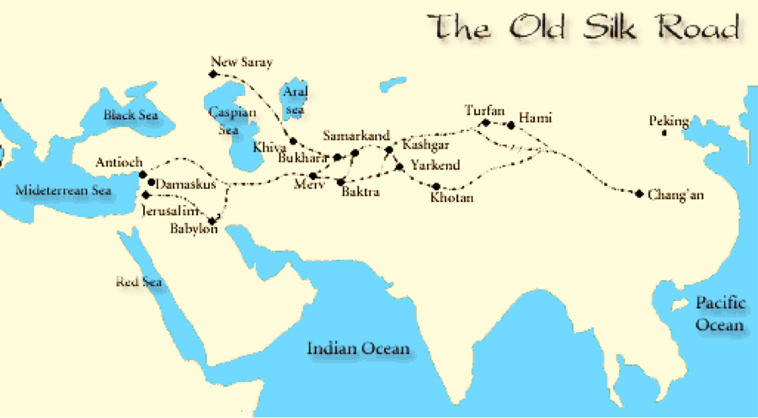
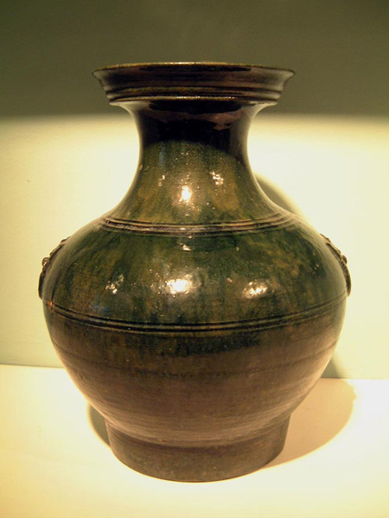
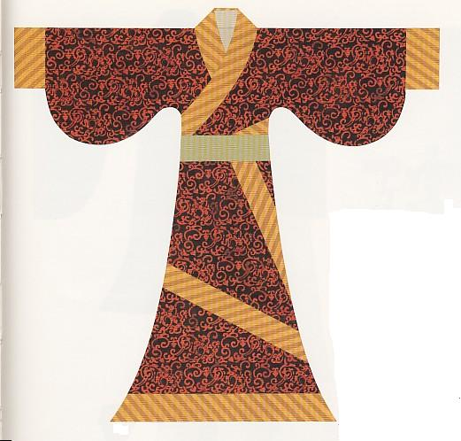
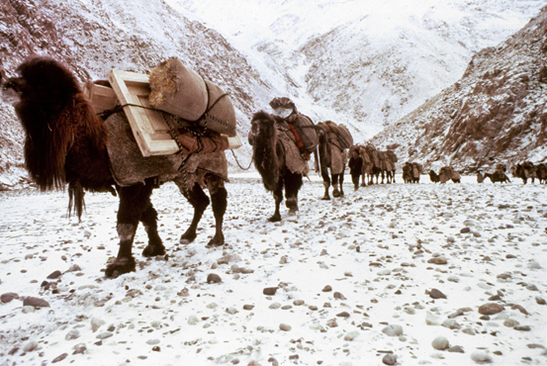

Slide 13
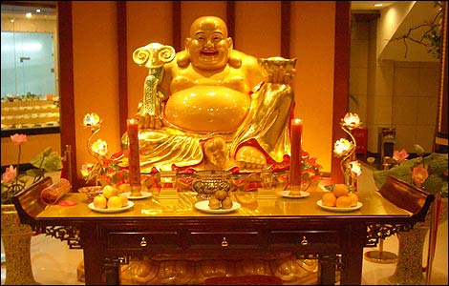
Cultural Diffusion in Religion
Buddhism from India – introduced to China by Central Asian traders.
It received little support from Han dynasty rulers, spreading only modestly among Chinese and largely among foreigners.

Slide 14
Religion
Han focused on Confucianism
Restored Confucian teachings that were abandoned during the Qin dynasty.

Slide 15
Confucianism
The importance of individuals knowing and doing what was expected of them.
Confucius taught that social order led to peace and harmony in society.

Slide 16
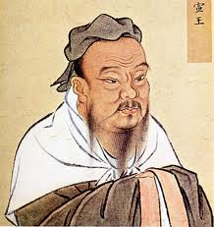
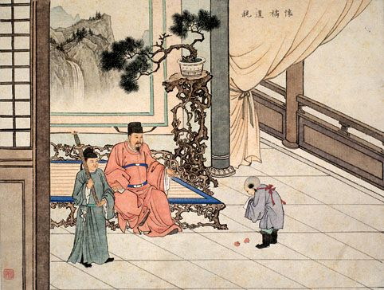
Confucius and filial piety

Slide 17
Peasants - majority of the population; paid the government, provided labor & services, served in the army
The merchant class traders, artisans, manufacturers
Commoner Class
most merchants were quite wealthy

Slide 18
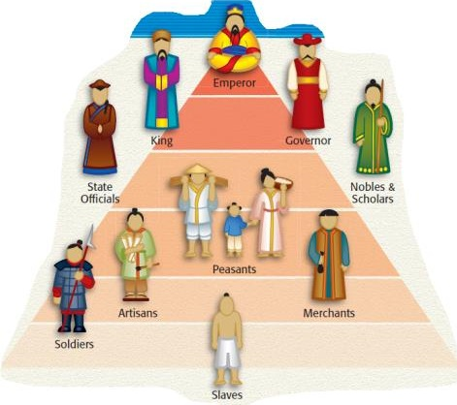
Examination system created a new social class - scholar-gentry,
educated landowners
- Examinations = way for commoners to move up the social ladder

Slide 19
Wealthy families had many children. They wanted their sons to serve in the government and their daughters to marry into other wealthy families. Under Confucian teachings, women were subordinate to men; marriages were arranged.

Slide 20
Intellectual
paper and cast iron tools invented,
painting and calligraphy flourished,
fine porcelain was created.
wheelbarrow and the iron plow.
water clocks, star maps, seismographs, and compasses.
Crossbow
new roads and waterways.
raising silkworms and spinning and weaving silk cloth,
which led to the invention of the weaving loom.

Slide 21
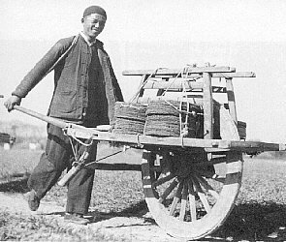
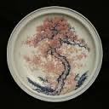
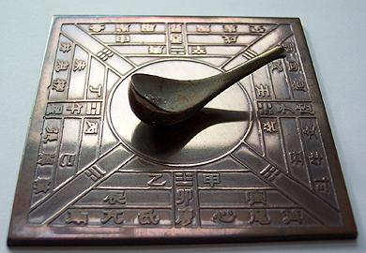
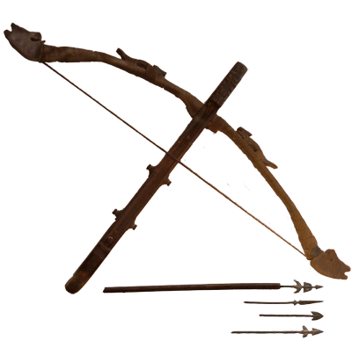
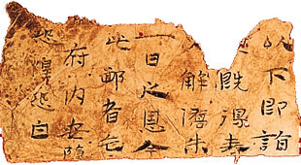
Magnetic compass

Slide 22
Area
The capital was Chang‘an, which had a central position (all major roads converged in Chang’an), and became the eastern end of the Silk Road. Han emperors conquered many new territories, expanding the reach of the empire as far as modern-day Korea and North Vietnam.

Slide 23
Growth and Geography
Ironworking contributed to substantial air pollution.
Intensive agriculture and logging stripped the land of its grass and forest cover
Soil erosion turned the Huang-He River its characteristic yellow-brown color.

Slide 24
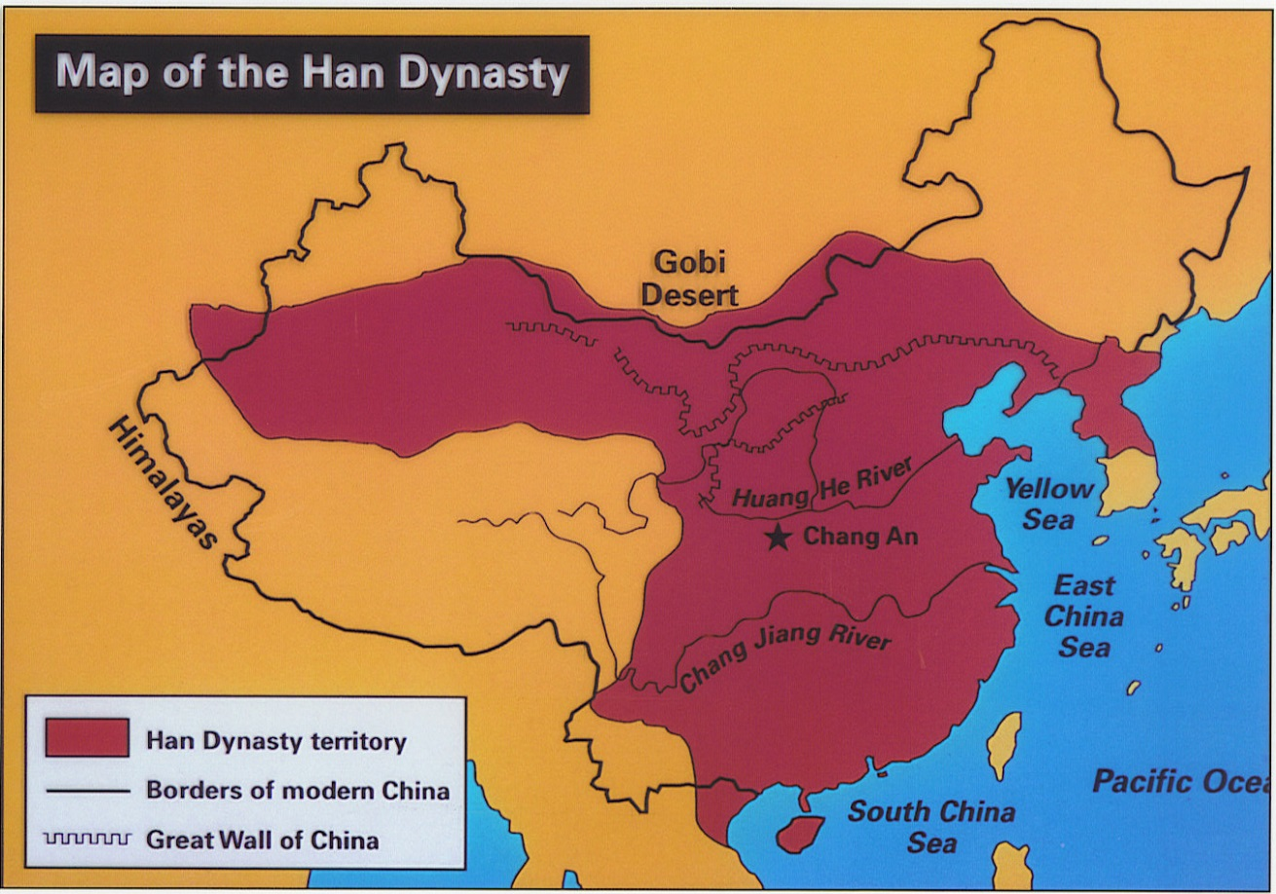
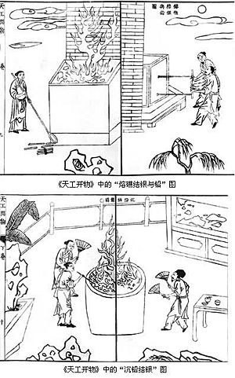
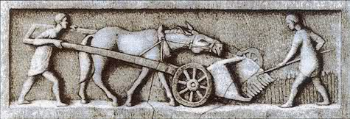

Slide 25
Processing
Create an acrostic poem about the Chinese Han dynasty
H
A
N
D
Y
N
A
S
T
Y

