Slide 1
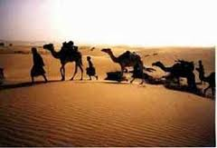
Bedouins
part of a predominantly desert-dwelling Arabian ethnic group traditionally divided into nomadic tribes, or clans

Slide 2
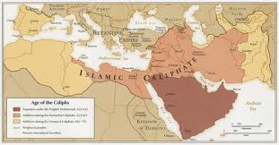
Caliph
Arabic successors who succeeded Muhammad in the role of leader of the faithful after the prophet's death

Slide 3
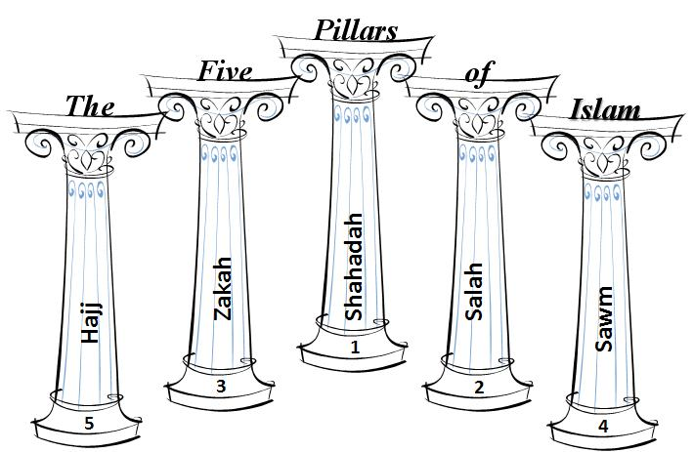
Five Pillars
five basic acts in Islam, considered mandatory by believers: faith, prayer, charity, fasting, pilgrimage

Slide 4
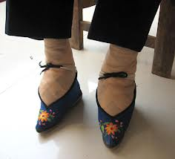
Footbinding
the custom of binding the feet of young girls painfully tight to prevent further growth

Slide 5
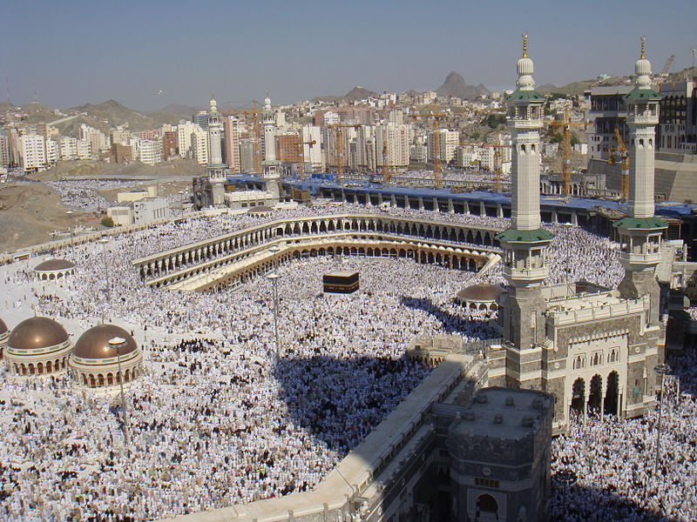
Hajj
the Islamic pilgrimage to Mecca, Saudi Arabia
the fifth pillar of Islam

Slide 6
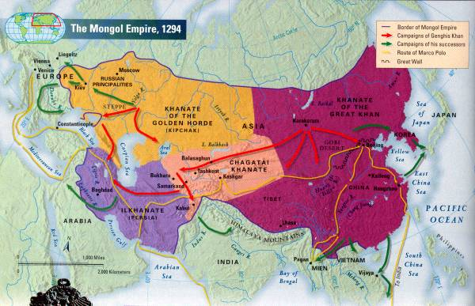
Khantate
the territory ruled by a khan (a Mongol ruler)

Slide 7
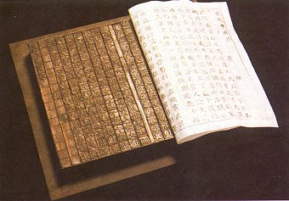
Moveable Type Printing
Characters were assembled to print a page and then broken up and redistributed as needed.
When the printing was finished, the pieces could be put away for future use.

Slide 8
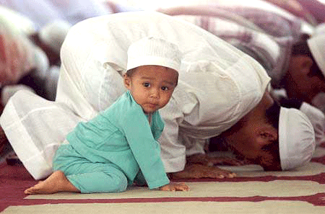
Muslim
a believer in or a follower of Islam

Slide 9
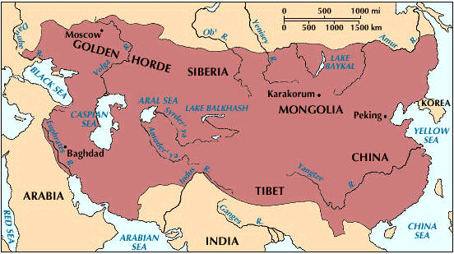
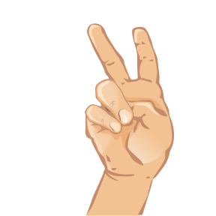
Pax Mongolica
a Latin phrase meaning "Mongol Peace"used to describe eased communication and commerce, and the period of relative peace that followed the Mongols' vast conquest

Slide 10
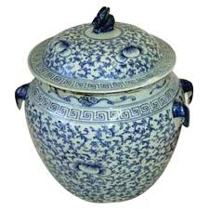
Porcelain
hard, white, translucent ceramic made by firing a pure clay and then glazing it with variously colored fusible materials
also known as china.

Slide 11
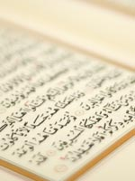
Shari’a
the moral code and religious law of Islam

Slide 12
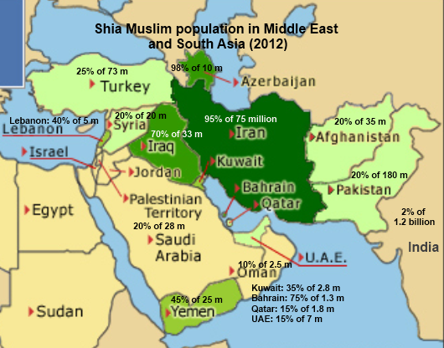
Shi’a
the second largest branch of Islam
believe the caliph should be a descendant of Muhammad

Slide 13
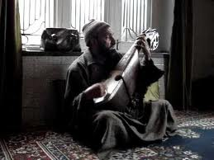
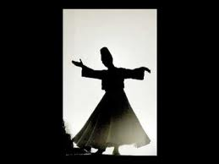
Sufism
the beliefs and practices of an ascetic, retiring, and mystical sect in Islam

Slide 14
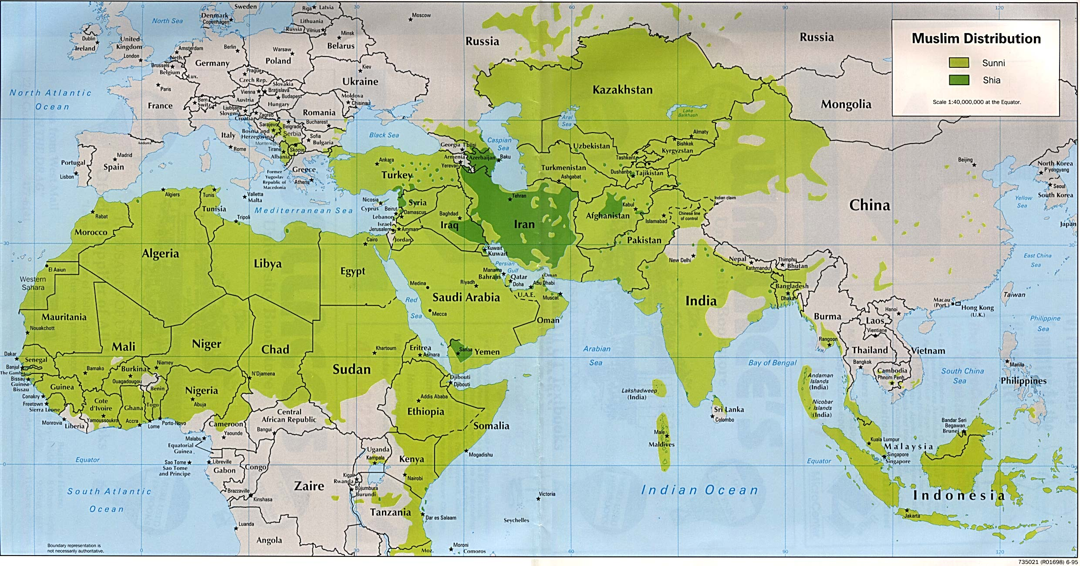
Sunni
the largest branch of Islam
believe the caliph should be elected from the people

Slide 15
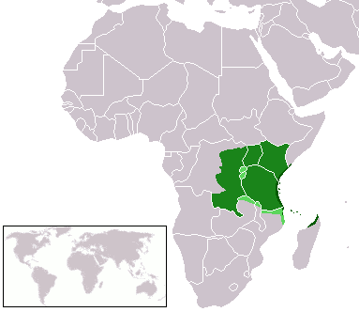
Swahili
derived from Arabic through twelve centuries of contact with Arabic-speaking inhabitants of the coast of southeastern Africa

Slide 16
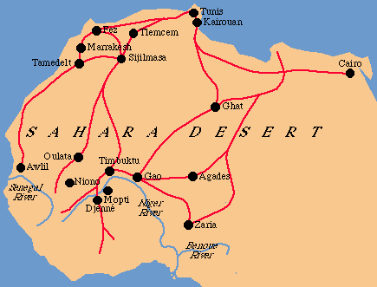
Trans-Saharan Trade
network of interlinking trade routes that connected North Africa and Sub-Saharan Africa.
also known as the Gold-Salt Trade

