Slide 1
Stalin and Totalitarianism
In this lesson, students will be able to define the following terms:
Joseph Stalin
Totalitarianism
Changes Under Stalin
Five-Year Plans
Gulags

Slide 2
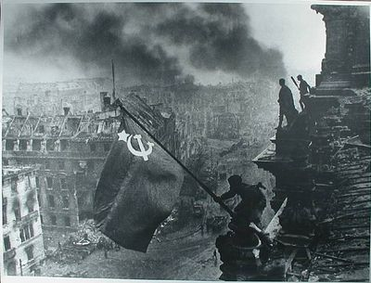
Those who supported Lenin and the
Communists were known as “Reds”.
The “Whites” opposed communism.
A civil war ensued. By 1921, the Red
army defeated the Whites. However,
in 1924, Lenin died.

Slide 3
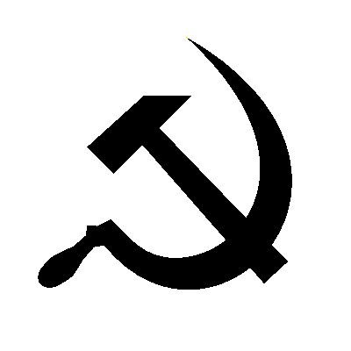
Lenin died in 1924 Who would take power? Trotsky or Stalin

Slide 4
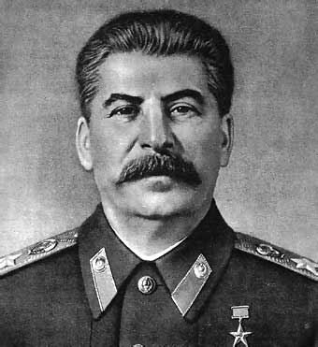
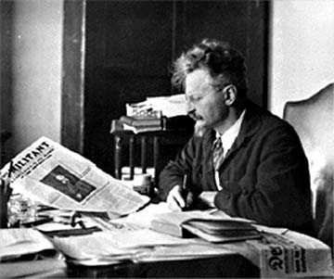
Joseph Stalin and Leon Trotsky competed
to succeed Lenin as leader of the Soviet
Union. Stalin gained control of the
government, expelled Trotsky, and
eventually had Trotsky murdered.

Slide 5
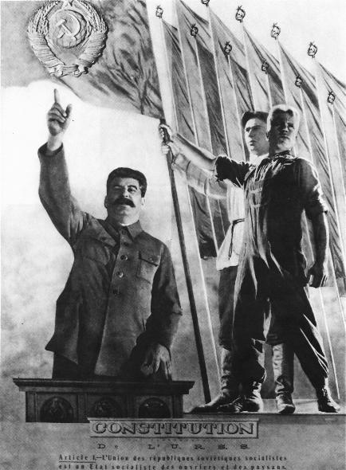
Stalin eliminated
rivals by accusing
them of being
disloyal to
Communist ideals.
Once in power, he
established a
totalitarian state. The Communist
party controlled all
aspects of individual
life.

Slide 6
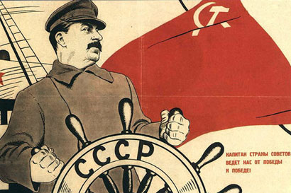
Totalitarianism is a political system in
which a one-party government controls
all aspects of individual life. Citizens
are denied the rights of free speech
and dissent. Secret police, censorship,
and terror are used to control people.

Slide 7
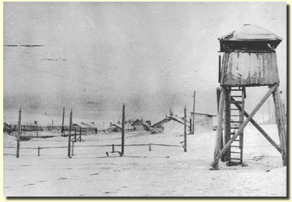
Stalin’s secret police arrested and
executed rival leaders. Slave labor
camps were built in cold Siberia. Millions
of people died in these camps or gulags.

Slide 8
A Leader’s Statistics:
- millions imprisoned or exiled
- 6 to 7 million killed by a forced famine
-millions executed
-4 to 6 million dispatched to forced labor camps
Final Death Toll is unknown but estimated to be
between 20-60 Million

Slide 9
The fundamental task of the five-year plan was to transfer our country, with its backward, and in part medieval, technology, on to the lines of new, modern technology.
The fundamental task of the five-year plan was to create in our country an industry that would be capable of re-equipping and reorganizing, not only industry as a whole, but also transport and agriculture—on the basis of socialism.
Joint Plenum of the C.C. and C.C.C., C.P.S.U.(B.) 1 January 7-12, 1933
The Results of the First Five-Year Plan
Report Delivered on January 7, 1933
https://www.marxists.org/reference/archive/stalin/works/1933/01/07.htm

Slide 10
Stalin Takes Power
The name Stalin means Man of Steel
Once in power, Stalin set out to make the Soviet Union a Modern Industrial Nation.
Stalin’s plan to industrialize the USSR was known as the Five Year Plan

Slide 11
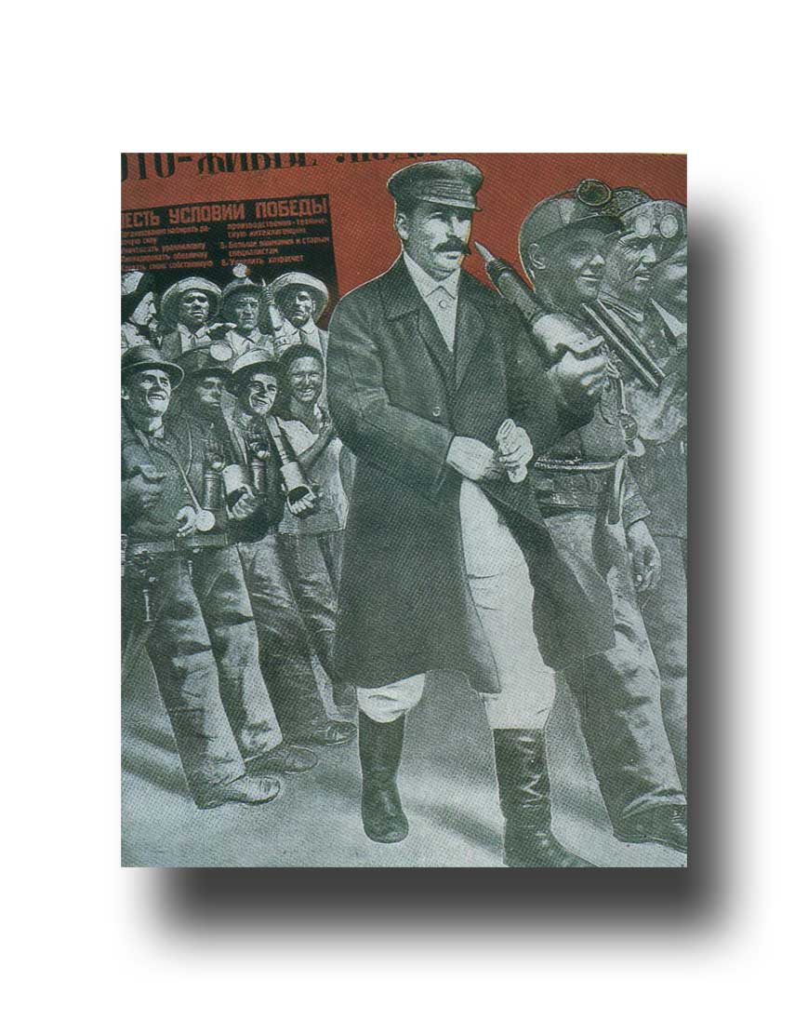
Stalin was determined
to industrialize the nation.
He introduced a
series of Five-Year
Plans to industrialize
the U.S.S.R. Heavy
industry was
developed while
consumer goods
were ignored.

Slide 12
Stalin’s Five-Year Plans
Aimed at building heavy industry,
transportation and increase farm output
Brought all economic activities under government control
Stalin set goals that must be met (quotas). Workers who succeeded received bonuses. Workers who did not were punished.

Slide 13
During the 1930s, oil, steel and coal production grew.
New railroads were built across the Soviet Union.
Stalin set goals that must be met (quotas). Workers who succeeded received bonuses. Workers who did not were punished.
During the 1930s, oil, steel and coal production grew. New railroads were built across the Soviet Union.

Slide 14
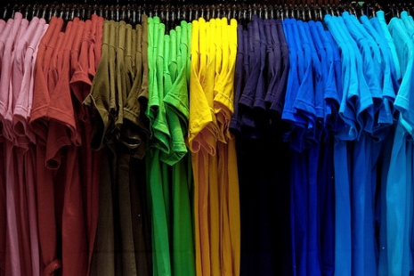
Mixed Results of the Five-Year Plan
The standard of living remained Poor
Didn’t focus on producing consumer goods

Slide 15
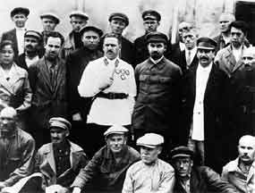
Revolution in Agriculture
Stalin also put agriculture under government control
Forced peasants to give up their land and live on state-owned farm called collectives which were large farms owned and operated by peasants as a group (Collectivization)

Slide 16
Peasants were allowed to keep their personal possessions but had to turn over all farm animals and farm tools to the government.
The government set prices and quotas
Peasants resisted collectivization by killing animals, destroying tools and equipment and burning crops.

Slide 17
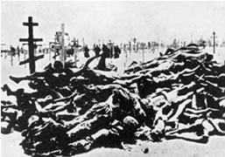
Peasants in the Ukraine rejected
collectivization. Stalin seized food
supplies and sealed off the entire
region. Millions of Ukrainians starved
to death.

Slide 18
Results of Collectivization
The government responded with brutal force
Forced Famine 1932-1933 – 7,000,000 Deaths
Increased Stalin’s control, but did not improve farm output
It was the official policy of the Soviet Union to deny the existence of a famine and thus to refuse any outside assistance. Anyone claiming that there was in fact a famine was accused of spreading anti-Soviet propaganda. Inside the Soviet Union, a person could be arrested for even using the word 'famine' or 'hunger' or 'starvation' in a sentence.

Slide 19
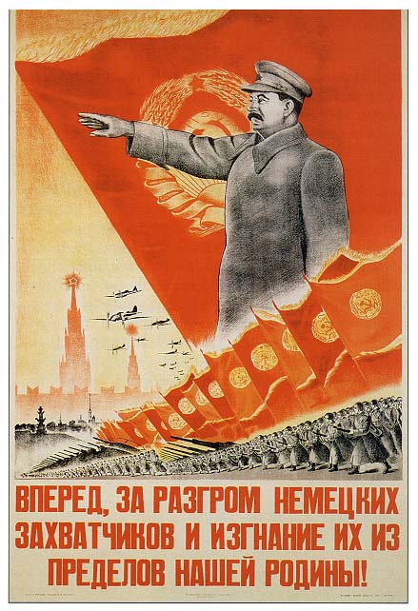
Stalin glorified his
part in building
the nation,
portraying himself as
Russia’s greatest
leader. His picture
appeared everywhere.
Children memorized
his sayings in school.

Slide 20
The Great Purge To Purge means to Eliminate opposition
In the 1930’s, out of fear that other Communist party members were plotting against him, Stalin launched The Great Purge
During the Great Purge, Stalin accused thousands of people of crimes against the government (treason)

Slide 21
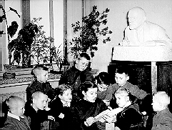
Stalin used the government to control
Soviet education, the economy, and
even music and the arts. Soviet
citizens only heard about Communist
ideals and successes.

Slide 22
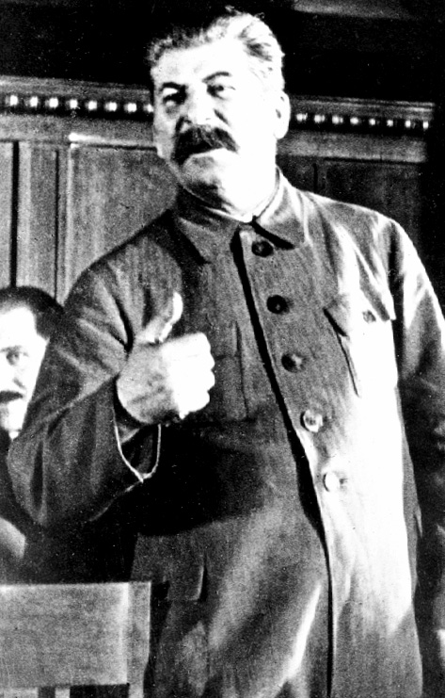
Stalin controlled
all aspects of life
in the Soviet Union.
He was a totalitarian
dictator.

Slide 23
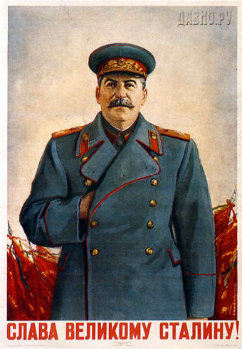
Russia was
transformed
by the Communists.
Life in the
Soviet Union
was controlled by
the Communist
Party under the
leadership of Joseph
Stalin.

Slide 24
Stalin targeted writers, teachers, army heroes and Bolsheviks through a Reign of Terror
During the Great Purge, Stalin tried these people in public. These trials were called show trials.
Many of the accused were tortured, executed or sent to prison camps

