Slide 1
The Holocaust Diaries
Stories of Strength, Hardship, and Defiance
ENTER
“For the dead and the living, we must bear witness.”
- Elie Wiesel

Slide 2
Holocaust Diary Database
Kate Bernath
Jakob Blankitny
Thomas Buergenthal
Alice Lok Cahana
Israel Cendorf
Irene Blasz Csillag
Chaim Engle
Miriam (Rot) Eshel
Sarah Peretz Etons
Haya Freidman
Manya Friedman
Fritzie Weiss Fritzshall
Mara Ginic
Helen Lebowitz Goldkind
Miroslav (Fred) Grunwald
Ernest Koening
Pieter (Peter) Kohnstam
Joseph Moses Lang
Abraham Lewent
Frima Laub
Heinz Raphael
Barabara Rebhun
Irene Safran
Leo Schneiderman
Tina Strobos
Home

Slide 3
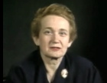
Kate Bernath
Born 1927, Szikszo, Hungary After the German invasion of Hungary in 1944, Kate and her family were deported first to the Kosice ghetto and then to the Auschwitz camp in Poland. Kate and other prisoners were sent on to the Plaszow camp, also in Poland. As partisan raids increased and the front drew closer, they were sent back to Auschwitz in August 1944. Kate was then selected for forced labor at a Messerschmidt factory in Augsburg, Germany. The prisoners were deported as Allied attacks intensified. Kate was eventually liberated after guards abandoned the train carrying the prisoners. “We were, uh, in the midst of all our troubles we were trying to cheer each other up. If one was feeling very low, we, we tried to tell them, we, we dreamed about things what we were going to do when we got liberated. We were all...we never thought for a minute, I never thought for a minute that I'm really going to die. I, it just did not sink in. I mean with all these horrors around me I, I always thought that we were dreaming of, of things--when I get home I'm going to do this and I'm going to do that and I just want to see this, this war end and just live for the day when we see the Germans defeated. And that kept us alive. Never to lose hope. If you lost hope, that was the end of it. It was so easy in Auschwitz. All you had to do is reach out for the barbed wires. They were electrified. We would not do them the favor. We said if they want to kill us, they'll have to kill us. We are not going to die.”
Database

Slide 4
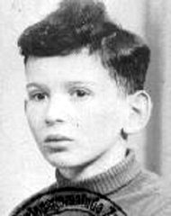
Jakob Blankitny
“After two days, our transfer to Auschwitz began; a terrible voyage under inhumane conditions. Among my most disturbing memories that I will never forget is when my mother gave the German soldiers her favors in exchange for half a glass of water. When we arrived at our tragic fate: Hell, I was only 16 years old and yet, even today, my ears echo the painful cries of the thousands of people there.”
“Upon our arrival we were separated by women and men. They took the women directly to the gas chambers and afterward to the crematoria - my mother and sister were among them!!!What pain, to see them taken to this place, never to return again. They divided the men into two groups; keeping my father and I united.”
“Upon our arrival, there were approximately 6,000 people, but only 200 people were left to enter Auschwitz. Upon entering Auschwitz, we were tattooed with numbers on our arms, which from that moment forward was our only identification; something which to this day for those who managed to survive, remind us every day of the horror which we had to pass through while the world, unfortunately, was deaf to our cries.”
Database

Slide 5
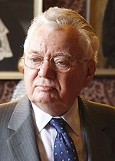
Thomas Buergenthal
In 1943 we had survived the liquidation of the ghetto. And we were in a work camp and suddenly one day there was the usual German selection process and there were 30 children still with us who were not killed in the ghetto. All of the people in the ghetto, incidentally, about 25,000 Jews in the ghetto of Kielce all ended up in Treblinka including my grandparents. They lined us up. They tore all of the children from the parents, the 30-odd children and when they started pulling me my father pulled the other way and he said, “Let’s speak to the commandant.” And I walked up and I to this day don’t know whether he prompted me to say or whether I said it. I looked at him and I said in German, which was my language, “Captain, I can work.” And he looked at me. And I don’t know what went through his mind, and he said, “We’ll see.” The other children were taken to the Jewish Cemetery of Kielce and killed with hand grenades. I was the only one to survive that experience.
I was nine years old and I can still hear the screams of those children…. All so young, all so innocent. This was also the last time I saw my father.
After a year and a half in Aushwitz, I was liberated by Russian troops. I was actually in an infirmary because on the death march I had frost bite, and I lost some toes and was in an infirmary. And when we were liberated, the Soviets simple said, “You’re free. You can go.” And the question was: where do you go? I was alone.
Database

Slide 6
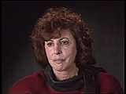
Alice Lok Cahana
“Several days later we arrived to Bergen-Belsen. And Bergen-Belsen was hell on earth. Nothing ever in literature could compare to anything what Bergen-Belsen was. When we arrived, the dead were not carried away any more, you stepped over them, you fell over them if you couldn't walk. There were agonizing...people begging for water. They were felling...falling into planks that they were not pulled together in the barracks. They were crying, they were begging. It was, it was hell. It was hell. Day and night. You couldn't escape the crying, you couldn't have escaped the praying, you couldn't escape the [cries of] "Mercy," the, it was a chant, the chant of the dead. It was hell.”
Germany occupied Hungary in 1944. Alice was deported to Auschwitz in the same year. At one time she was selected for the gas chamber, but survived because of a malfunction. As Allied forces approached the camp, Alice and other inmates were evacuated to the Guben labor camp. Alice, her sister, and another girl escaped during a forced march from the camp but were found and sent on to Bergen-Belsen. Alice's sister was taken to a Red Cross hospital, but Alice never saw her again. After the war, Alice emigrated to the U.S.
Database

Slide 7
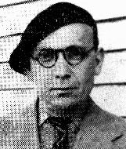
Israel Cendorf
Israel was born into a religious Hasidic family who hoped he would become a rabbi. But Israel rebelled and apprenticed himself to a printer when he was 16. He read constantly, deepening his sympathy with the workers' struggle, and he soon began to write his own revolutionary songs. His first book of poems, The Red Agenda, was warmly received.
To support his family, Israel peddled wood from door to door. He continued writing. He joined the Writers' Union and wrote for the New Press.
The Germans occupied Paris in June 1940. Israel worked for 11 months with the antifascist underground until he was arrested and deported to Pithiviers, a transit camp of 2,000 Jews. There he helped organize the underground, set up cultural evenings and continued writing. He would go from shack to shack, reading his poems to the other prisoners. One poem, "Our Courage Is Not Broken," was sung as the camp's anthem: "Our courage is not shackled/ Life is marvelously beautiful..." In May 1942 he was put on a transport to Auschwitz.
Israel died in Auschwitz. Many prisoners from Pithiviers sang his song "Our Courage Is Not Broken" on their way to the gas chambers.
Database

Slide 8
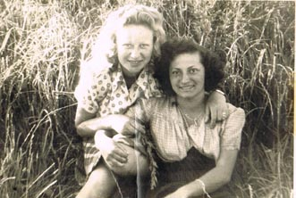
Irene Blasz Csillag
“In 1944 the Germans occupied Hungary. Shortly after the occupation, we had to wear the yellow star. I still went to work though, every day. Then a strict curfew was established for us Jews and four weeks later, we had to move into the ghetto that was created in Satu Mare itself. The ghetto was enforced approximately four weeks. Then, during the month of May 1944, we were deported.
We had arrived at Auschwitz-Birkenau. They took us all into a very large hall where, immediately, some men and women shaved off our hair. They then ordered us to undress; take off everything.
My grandparents, my aunt, and my cousins who were too young; were sent to the left. The Nazis didn't need them. We never saw them again. None of them came back. Not one.
I was saved after almost a year at Auschwitz when the SS forced us to march. We dragged ourselves for a few hours, when we noticed that there were fewer and fewer SS soldiers with us. They were running away. Finally they all disappeared. We shortly arrived at a soccer field, where we saw all these jeeps with soldiers in them. They were throwing chocolates and cookies and cigarettes to us. People were yelling "the British are here, the British are here."
Database

Slide 9
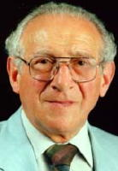
Chaim Engle
“Our neighborhood in Lodz was predominantly Jewish, so most of my friends were Jews. As a young adult I began my compulsory army service. On September 1, 1939, only two weeks before my tour of duty was scheduled to end, the Germans invaded Poland. After a few weeks I was taken as a POW. One German captor learned I was Jewish, but he didn't shoot me. I was taken to Germany for forced labor.”
“In March 1940 all Jewish POWs were returned to Poland. I was deported to the Sobibor death camp in the summer of 1942. In October 1943 a small group of prisoners revolted. I stabbed our overseer to death. With each jab I cried, "This is for my father, for my mother, for all the Jews you killed." The knife slipped, cutting me, covering me with blood. Chaos took over; many prisoners ran out the main gate. Some stepped on mines. Some gave up and didn't run at all. I grabbed my girlfriend and we ran into the woods.”
Chaim hid in the Polish woods with his girlfriend, Selma. After the war they married and lived in Europe and Israel. The Engels settled in the United States in 1957.
Database

Slide 10
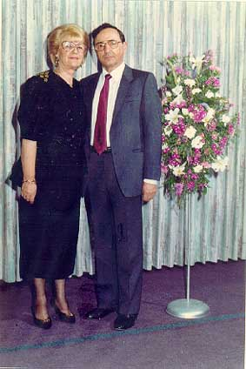
Miriam (Rot) Eshel
“We arrived in Auschwitz. I was carrying my little sister, and my mother carried the one who had been sick, who was still very weak. When we got off the train, we came to the crossroad where ... [the SS man] stood there like a conductor with a baton. He motioned to me to let go of my little sister. When she saw this, my mother let go of my other sister and took in her hands the little one (who still could not walk). People were sent to the right, to the left… As far as I remember, I went to the right and they to the left. My mother started to yell: "My Mirale, come to me, come to me." But the SS men were already pushing me forward with the butt of the guns.”
“It was the beginning of May 1944, I think. I was 13 and a half. They told us to undress completely. We did. They took away our jewelry and all other belongings. I never saw my mother or sisters again.”
“We received a soup portion once a day, and we were so hungry that we expected it eagerly… until one day I saw a human finger in the soup, and from then I couldn't eat it anymore. Selections were made almost regularly once a week and those found unfit for work were deported.”
Miriam was liberated by Russian troops in 1945 while on a death march from Auschwitz. She now lives with her brother who also survived at Auschwitz.
Database

Slide 11
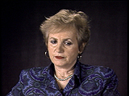
Sarah Peretz Etons
“I was in that shack hiding for over two years. Never went outside. Uh, in the winter it was very cold; in the summer it was hot. And, um, he used to bring us, uh, usually, uh, a loaf of bread for both of us every day and a bottle of water. Once in a blue moon for a special occasion he would bring a little soup. And, uh, sometimes he had, if he had to go away on business where they send him to another town for a day, or some other, he would, his wife or his daughter will never give us anything so we starved for a day or two until he came back.”
“And my mother and I been in that, uh, uh, shack for--at night sometimes, my mother used to sneak out to clean up the [chamber] pot, and, uh, I never went out. Uh, she wouldn't let me out, and I was afraid to. We didn't have anything to do. I didn't have anything to play. I was at that time six years old, and I didn't know...I used to play with the chickens and play with the straws on the floor, there was a lot of straw on the floor and he used to put up, uh, a kind of a mattress or something where we slept in a corner with blankets, and that was where we stayed. If it wasn’t for him, I would have died like my father and brothers . . .”
Database

Slide 12
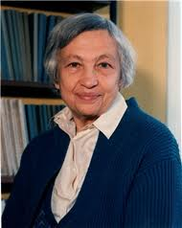
Haya Freidman
“On a snowy November day in 1944 at Auschwitz ( I was 19 years old), they called us together and crammed us again into railcars, 80 girls in a railcar that was meant for eight horses and sent us away. After a few days of starvation, we arrived to our unknown destination and they led us off the train. It was dark; thick, white snow was falling, we saw lights somewhere far away and despite the darkness, we realized we were in the mountains.”
“It was one of those model concentration camps -- i.e., the camps they displayed to the Red Cross to show the world that Jews were used as laborers in work service; they weren’t working for the German army. (They didn't show the Red Cross places like Auschwitz and its crematorium, that's for sure!)”
“I was starving most of the time there and was beaten several times by the SS. The SS were very cruel to the women here. When there was a women dieing they would beat her to speed up the process of death. Luckily I kept working until one day American soldiers walked through the gates of the camp and told us we were free. But where would we go…I had lost everything.”
Database

Slide 13
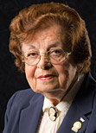
Manya Friedman
German troops invaded Poland on September 1, 1939 and three days later, Sosnowiec was occupied. Jewish men, including Manya’s father, were rounded up and the next morning marched to a factory. Orders were issued by the Germans in charge that: Jews had to turn in all valuables, Jewish merchants must relinquish their businesses, and Jewish children were no longer allowed to attend school. New passports were required for all the Jews and the ghetto was formed. All Jews were made to wear identifying armbands and later, the yellow Star of David badge.
In March 1943, she was taken from the uniform factory to the Gogolin transit camp, and later to the Gleiwitz labor camp where she was tattooed with the number 79357, which became her name. At the end of 1943, Manya’s family was deported to Auschwitz when the ghetto was liquidated; she never saw them again.
After the Soviets liberated Poland and her work camp, Manya was taken in by the Red Cross. Today she volunteers as the United States Holocaust Memorial Museum.
Database

Slide 14
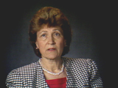
Fritzie Weiss Fritzshall
Born 1929, Klucarky, Czechoslovakia
Fritzie's father emigrated to the U.S., but by the time he could bring his family over, war had begun and Fritzie's mother feared attacks on transatlantic shipping. Fritzie, her mother, and two brothers were eventually sent to Auschwitz. Her mother and brothers died. Fritzie survived by pretending to be older than her age and thus a stronger worker. On a death march from Auschwitz, Fritzie ran into a forest, where she was later liberated.
“My grandparents, my aunt, my relatives and all the other Jews in the community, we were all loaded onto this train, going to Auschwitz. When we were put onto this train, which of course I don't need to describe to you--it was a cattle car as you know, no windows, had no seats and no toilet. When we got onto the trains none of us knew we were being taken to a concentration camp. None of us knew anything about Auschwitz. At least I don't think we knew. We honestly thought we were going to be relocated, until the door closed and we heard the lock go on from the outside. I believe that was the first we knew, wherever we were going to be taken to, it was not going to be freedom. So many people died among the confusion in the car. It felt like an eternity those three days.”
Database

Slide 15
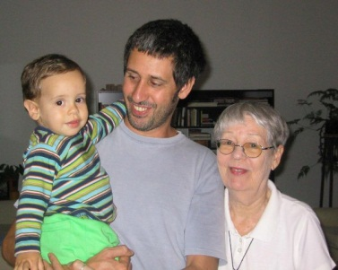
Mara Ginic
“In April 1941, a few weeks after Hitler's troops occupied Belgrade my father and I escaped with the help of my Catholic and ethnic German mother to Split, occupied by the Italians. In December of the same year, the Italians deported us to a small town in Piedmont, Castellamonte, in northern Italy, where we were interned as civil prisoners of war.”
“My father, some friends and I fled to the mountains with the intention to cross over to Switzerland. After an adventurous, dangerously unsuccessful try we were able to find a guide in Breuil (Cervinia). We spent two weeks in the mountains until we reached Switzerland.”
“We remained in Switzerland until the end of the war. Meanwhile I had married my husband Ivo Kraus and we decided not to return to Yugoslavia, but go to Italy. From Italy we emigrated to Argentina. My father moved to Yugoslavia, only to flee the reign of Tito and move to Brasil. I spent most of my life running, now I want to live.”
Database

Slide 16
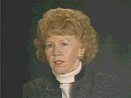
Helen Lebowitz Goldkind
Helen was about 13 when she and her family were deported to the Uzhgorod ghetto. They were then deported to various camps. Helen and her older sister survived Auschwitz, forced labor at a camp munitions factory, and Bergen-Belsen. When Helen was too weak to move, her sister would support her during roll call and drag her to work, knowing that labor was the only chance for survival.
“Then you see these mothers coming down with little kids, and they're...and they're trying to pull these kids out of their mother's hands. And you know, when you try to separate a family, it's very difficult. It's very difficult. People put up fights. It...it, there was so much screams. So, there was a truck. I remember that truck. So the parents, the...the mothers that wouldn't give up these children and they, they were beaten up, and the kids got hurt, so they grabbed these kids and they threw them on the truck, and they really didn't look how they were throwing them on the truck.”
“So at that time we saw that something horrible is happening--the way these people were behaving to little children, to little babies. And of course on that truck there were people, you know, very sick people going, you know, they were throwing sick people there and...and...and these children that gave them a tough time. They were just thrown on the trucks. And there were so many mothers that were running after the trucks, and of course they beat them and they pushed them back.”
Database

Slide 17
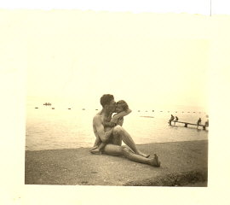
Miroslav (Fred) Grunwald
“The first time it was my turn to be interrogated, I nearly fell asleep in the office of the Gestapo officer but I soon was wide awake, after being slapped twice on my face. That was my first realization what Gestapo behavior meant. A telegram was shown to me (in German, my mother's language) from the German headquarters in Zagreb, that I was not a Christian resident of the formerly Italian occupied territory, not an Italian citizen, but simply a Croatian Jew in hiding.”
“For repeatedly lying, the officer slapped me hard and sent me back to the “cell”. By now out of the 14 inmates who had come with me, only seven remained. I heard a rumor that one was released, one was shot and the others transferred to other prisons or jails.”
Fred was a Holocaust survivor who spent several years in Dachau. He was prisoner # 60648 (listed as an Italian national under the name of Gruenwald). Fred's wife, Ruth, was Catholic, but she was also a concentration camp survivor. Ruth was sentenced to one year in the camp for helping Jewish families escape from the Nazis. Fred died of a stroke in 1987 while watching a Holocaust documentary “Shoah”. His wife died 15 years later.
Database

Slide 18
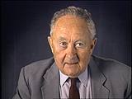
Ernest Koening
“In Laurahuette work was very, very, very difficult. I remember we were assigned together--I was assigned--to dis...we were dismantling one of the old blast furnaces, and we were carrying heavy pieces of wood which had been in this blast furnace. And, you, know that was so heavy that, uh, perhaps eight men had to carry this. But some of them were very weak from the beginning, and if one couple--there were perhaps four couples--if one couple releases, or didn't, didn't carry enough, the others couldn't, and the whole thing fell down, and injured people. When we couldn't lift it we were beaten. And one of the things from the concentration camps which I have never understood: sometimes people have been beaten with iron bars, and you would think they have been injured, sometimes they were injured, sometimes they were killed. That was the first month In Laurahuette.”
Ernest was a studying in France when he joined the French Army. After france fell, he was deported to Laurahuette (a subcamp of Auschwitz where forced laborers worked in mines and furnaces). He was in Laurahuette until August 1943, when he was sent to the Blechhammer subcamp of Auschwitz. After liberation, Ernest eventually made his way to the United States.
Database

Slide 19
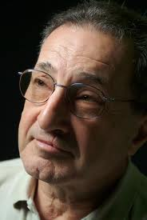
Pieter (Peter) Kohnstam
“The soldiers burst into the room, led by a Nazi officer who waved his pistol at us and shouted, “Be still, or you will be shot.” The soldiers were too busy putting tags with the SS insignia on our furniture and belongings, and paid no attention to us. The officer explained that, because we were being deported, they were claiming possession and ownership of everything we had. We would be committing a crime if we removed so much as a toothpick from our apartment.”
It was by chance that the Kohnstam's apartment in Amsterdam was downstairs from the family of Anne Frank. Ruth became a close friend of Edith Frank, and Anne, the youngest daughter, became Pieter’s babysitter. Both children attended the local schools in the neighborhood.
When Nazi persecution of Jews in The Netherlands became intolerable, the Franks went into hiding, but Pieter’s parents decided to flee Amsterdam. After a year-long trek through Belgium, France and Spain, they reached safety and freedom in Argentina.
Database

Slide 20
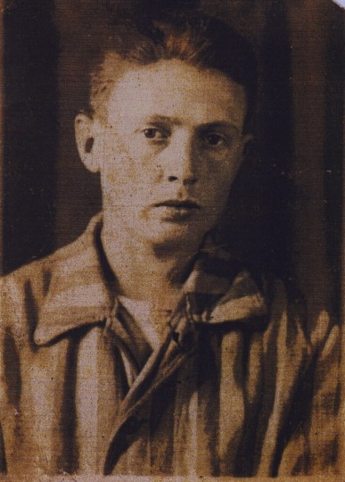
Joseph Moses Lang
On June 7, 1944, my 17th birthday, we were transported by cattle car, along with hundreds of others, to Auschwitz. All of us on the train were already very malnourished and the conditions on the train were terrible. Upon arriving at Auschwitz, men and women were immediately separated and this would be the last time that Meir and I would ever see our mother and sister.
Several times I was beaten very badly. On one occasion, I was accused of not lining up on time and I was sent to the “dentist” who then yanked out my wisdom teeth with a chisel and hammer. Though this caused me to bleed severely, I still had to report for work the following day.
After Auschwitz was liberated, I was taken to an infirmary in a nearby town for six months of treatment. During this time, I lost track of where Meir, my brother was taken. I found him a year later in a hospital outside of Allach in 1946.
Database

Slide 21
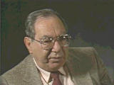
Abraham Lewent
After losing my father to SS guards shooting him for no reason, the SS returned to take the rest of the men to the camps. So I was hiding in the house and my mother went downstairs with my three sisters, because at this time they were only taking men. This is the...the last time I saw them. Because the Germans, they took them out, for no reason they took them. That time they took about ten thousand people to the place Umschlagplatz where they took the people to Treblinka.
I was laying, hidden in a room in the top of the ceiling. But it actually was like a hideaway on the top of the ceiling. And I was laying there, and I heard the Germans came into the house and they take them out downstairs. I didn't know what to do, what to say. I knew I would be killed if they found me hiding. My mother looked up at the ceiling right before they took her away. I still see her face…
I hid in that ceiling for almost a year, only leaving to scavenge for food. Luckily I made my way out of the city and hid with a Polish family in the country.
Database

Slide 22
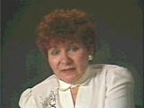
Frima Laub
We had the pogroms and we had starvation. We had everything. There was a lot of atrocities going on. Uh...horrible experiences. Always frightened, always feeling you're being followed. In fact the nights when I used to walk the streets and I used to hear the German Shepherds bark, to this date I dislike these dogs. Afraid so. And I always used to feel that any minute, you know, they will detect something, attack me although it was at night and I used to walk, like you...against...against building, between...between trees [so] nobody should see me, nobody should hear me. And everything brings memories.
When it drizzles and it's cloudy, it brings memories of the day when they took us to be killed, the first pogrom. When I hear a German Shepherd, it brings memories. When I walk the streets, everything seems to bring memories. It's quite frightening. It is hard to forget these things today as I try to have a new life, but the numbers on my arm will never fade.
Database

Slide 23
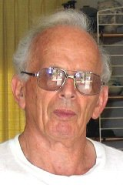
Heinz Raphael
Not long after this, in November, there followed the fateful Night of Broken Glass, I was in bed, ill with the measles. The Gestapo visited us in the morning. They knew my father from his visits as "Seelsorger" ("minister") to the Jews in the local prison. The living room was demolished. Bookshelves and sideboard were toppled over. Our large Goethe (!!) portrait was smashed with an axe. The place looked very much in shambles.
After this my uncle Leo (Fischer, my mother's brother) succeeded to get a visa to Sweden, for my mother and myself. That was actually already in June of 1939. I don't really know why it took us until the end of August to leave Germany. We made the arrangements to take our furniture and other belongings with us. We left beofre this for fear that the SS would come and take us away. I was very lucky to get out, I know that many others did not, I wish I could have taken them with me.
Database

Slide 24
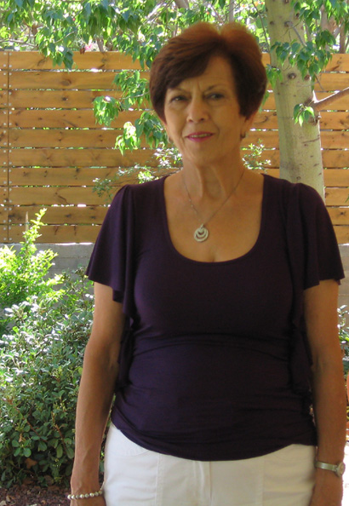
Barabara Rebhun
As a child, I survived the Holocaust in Poland. I have lived in Israel since 1950. I only learned that I was adopted at the age of 16 in 1958. I was born in the Warsaw Ghetto in 1942. I was smuggled out of the Ghetto (with the help of a German soldier or guard!) to the Aryan part of Warsaw at the end of 1942 or beginning of 1943. I was then about nine months old. It was before the Warsaw Ghetto uprising.
I was handed over to a Christian woman, Charlotte Rebhun, who was married to a Jew and had lived in Berlin. Because she had a Jewish husband, Max Rebhun, she and her husband and two children were expelled to Poland. Her husband perished in Treblinka. Charlotte gave shelter to eight or more Jews. I lived with the family until the Polish uprising in September 1944.
When the Allies arrived in Poland they took many of the orphans with them and I was later adopted to a Jewish family that also survived the Holocaust.
Database

Slide 25
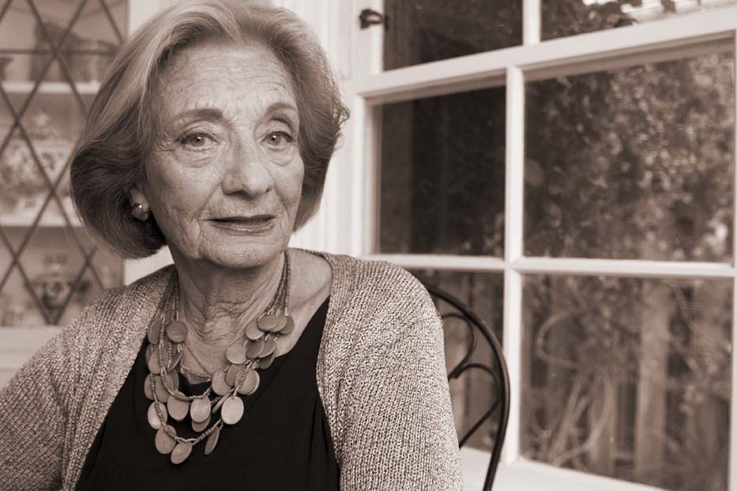
Irene Safran
My journey to Auschwitz-Birkenau began on May 19, 1944 when I boarded the train with my parents, three younger sisters and two brothers. Our homeland, Czechoslovakia, had been annihilated in March of 1939. We arrived at a brick factory along with hundreds of other people from the ghetto, and we were told that it would be several days until we were moved to the rail station to board our train for relocation. We waited at the brick factory for five days while German and Hungarian soldiers stood guard. We all built temporary shelters for ourselves from the bricks that were scattered around. The soldiers tortured us there for their personal entertainment. We had to climb in and out of the little brick shelters like dogs. The soldiers hit people with a stick while making them jump around on all fours, and after they had their laughs, they sent them back to their holes.
I never saw my sisters or mother again after that day. I remember thinking that soon I would be dead and be with them again. When Auschwitz was liberated, I began my new life. Today I live for them.
Database

Slide 26
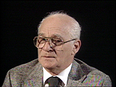
Leo Schneiderman
It was late at night that we arrived at Auschwitz. When we came in, the minute the gates opened up, we heard screams, barking of dogs, blows from...from those Kapos, those officials working for them, over the head. And then we got out of the train. And everything went so fast: left, right, right, left. Men separated from women. Children torn from the arms of mothers. The elderly chased like cattle. The sick, the disabled were handled like packs of garbage. They were thrown in a side together with broken suitcases, with boxes. My mother ran over to me and grabbed me by the shoulders, and she told me "Leibele, I'm not going to see you no more. Take care of your brother." I never saw her again.
I survived with my brother at Auschwitz for over a year until liberation. I live here in the United States now and volunteer at the museum.
Database

Slide 27
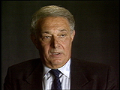
Steven Springfield
After we arrived in Danzig, when we heard that we were going to Stutthof, we were devastated because Stutthof was a camp which was very well known as one of the worst. The conditions in Stutthof were beyond any description. People were dying left and right from hunger. People woke up in the morning, next to you people were dead, emaciated. And the condition was deteriorating by the day because the tide of the war had turned and as bad as it was before, now the Germans were letting their anger out on the few remaining Jews because they were losing the war.
My brother and I were being deported from Stutthof, but as my father was going across to join us, the German officer noticed that he was invalid--he was dragging a leg as a result of scarlet fever which he had in his youth. The minute he noticed that he says, "You cannot go. Back." My brother and I started pleading, "It's our father. We have to go together." Just to spite, he says, "You're going and he's staying here." And no matter how much we begged and no matter how much we pleaded and cried, it did not help. We were kicked and beaten and forced to leave my father. It was clear to my brother and myself that my father would be left in Stutthof and he would be doomed. And we were...we were absolutely heart-broken to leave him there, because we knew it was going to be the end. But we were forced to do it and that's how we left Stutthof.
Database

Slide 28
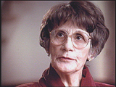
Tina Strobos
“When we started taking in people we realized that they had to get away if the Gestapo came. So we had a first floor on which electrical button could open the door and so you could look through a wall window to the door downstairs on the first floor and see who [was] coming in. Then we had a alarm that we rang for the third floor so the people on the third floor could creep out the window in the gutter and get lost and go to the attic on the back side of the house. And we rehearsed that, to get out of the window and out in there quietly, very fast.”
“So when, time came and a man called and he said, "I'm a carpenter from the underground." And he had tools with him, and he looked so honest and reliable, we trusted him. My mother said, "Do you know this man?" I said, "No, but let him make a hiding place." And he made such a good hiding place that when I go back to that house it's very hard to find. It doesn't hold too many people, though, two or three, crammed sitting together.”
Tina helped to save over 25 Jewish people during the Holocuast.
Database

