Slide 1
The Cold War Comes Calling

Slide 2
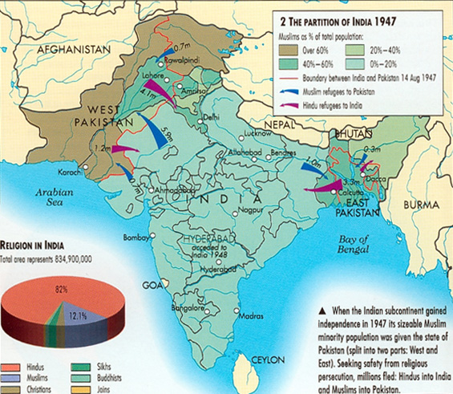
Partition of India
Following independence in 1947, India is partitioned into Hindu dominated India and Muslim dominated Pakistan.

Slide 3
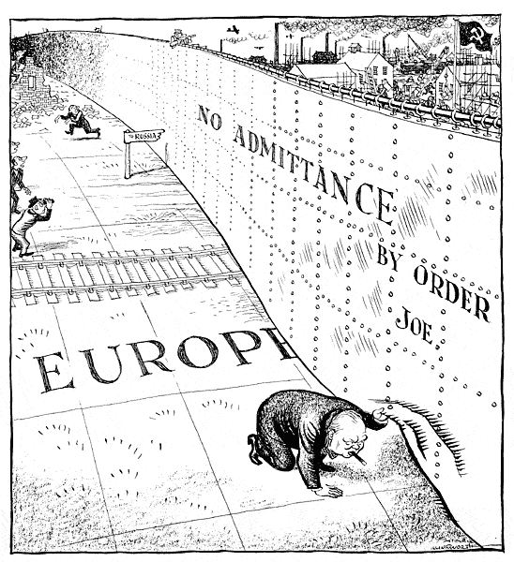
The Cold War
1947 was also the dawn of the Cold War the conflict for world domination between the United States and the Soviet Union.

Slide 4
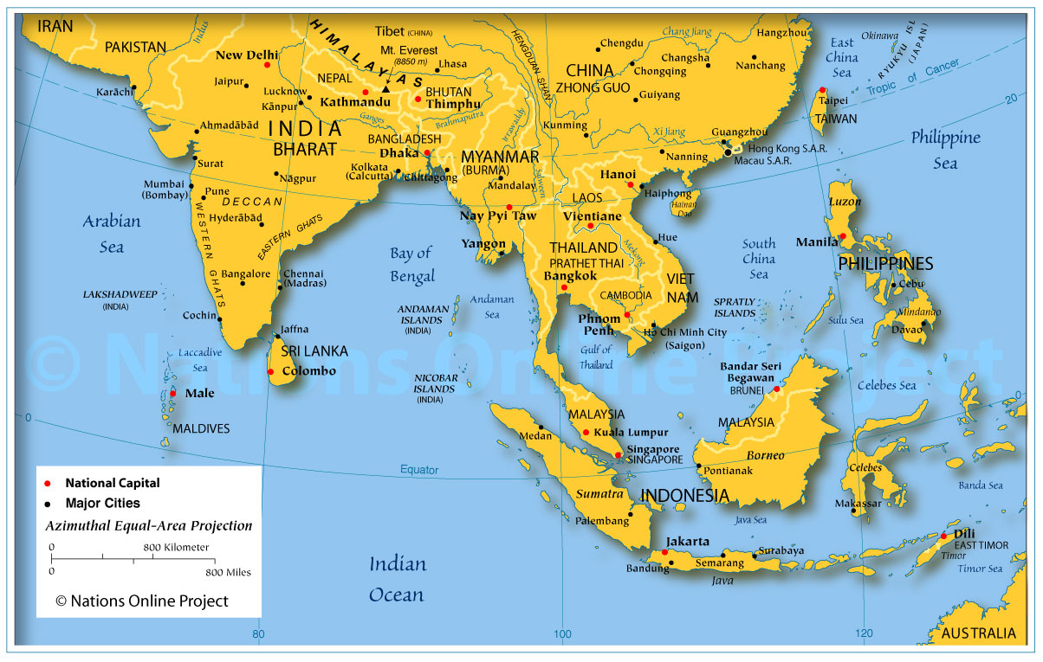
Alliances in South Asia
Both the U.S. and the U.S.S.R. looked to South Asia for new allies in their conflict with each other.

Slide 5
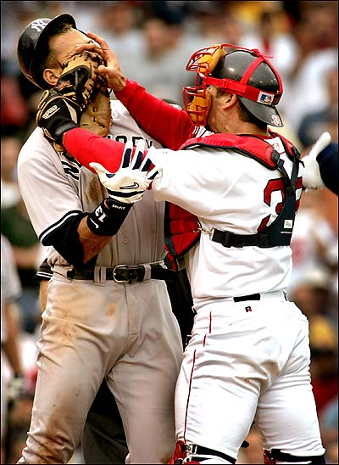
Rivalries
America and the Soviets cared little about the individual issues that divided India and Pakistan.
Instead the Superpowers tried to use the existing rivalry and jealousy between the two South Asian neighbors to benefit themselves.

Slide 6
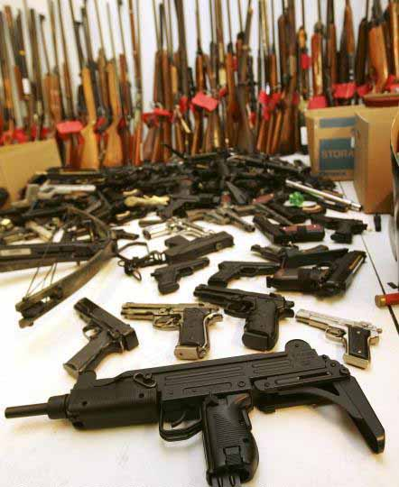
Promises
America and the Soviet Union both promised aid and advanced weapons in exchange for alliances with India and Pakistan.

Slide 7
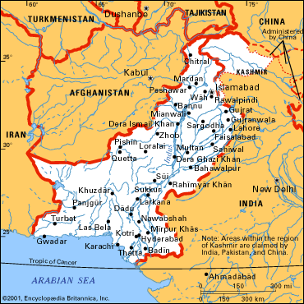
Pakistan
Pakistan chose to ally itself with the United States and the West.

Slide 8
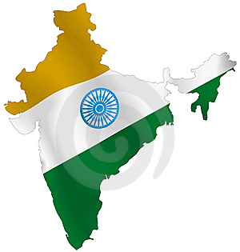
India
India chose non-alignment, meaning they did not choose one side, instead India chose to gain from both sides never actually committing to one.

