Slide 1
The Rise of Fascism in Italy

Slide 2
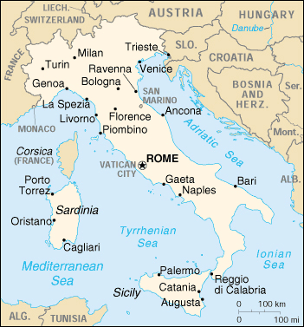
World War One
Italy was originally a member of the Triple Alliance with Germany and Austria
In 1914 when war broke out Italy remained neutral
In 1915 Italy joined the Allied Powers Britain and France after being promised the Austrian province of Trieste. Trieste had a large population of Italians
Why did Italy join the Allies in World War One?

Slide 3
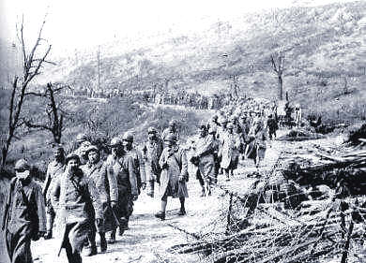
Sold Out!
Treaty of Versailles unfair to Italy!
Coveted territory granted to Yugoslavia
Millions of Italians die in vain!
Italian prisoners after the battle of Caporetto
Why did Italians feel as if they were treated unfairly by the Treaty of Versailles?

Slide 4
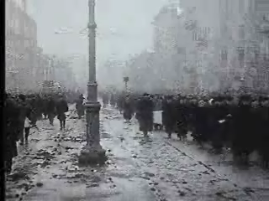
Post War Italy
No jobs for veterans
Workers Strike
Workers take over factories
Peasants seize land
Trade declines
Taxes rise
Upper classes fear a Communist Revolution
Russians rebelling against their Czar in 1917
Why would upper class Italians fear a Communist Revolution in 1920?

Slide 5
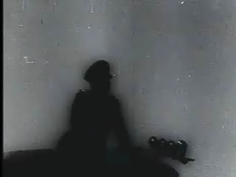
Benito Mussolini
A Fierce nationalist
A great public speaker
Appealed to Italian patriotism (nationalism)
Supported by the Industrialists
Il Duce was Mussolini’s nickname. People chanted it in his honor
How did the Italian people react to Mussolini?

Slide 6
Fascism Vs. Communism
Mussolini’s Italy
No freedom of speech
Censorship of the press
Active secret police
Nationalization of the industries under control of the owners
Stalin’s USSR
No freedom of speech
Censorship of the press
Active secret police
Nationalization of the industries under the control of the government
What is the main difference between Fascism and Communism?

Slide 7
The Political Spectrum
Democrats
Radicals
Looking for violent change. People who wish to completely turn society upside down
Liberals
Open to change usually looking for more freedom and rights for the people
Moderates
In the middle of the spectrum these people are literally in the middle. Advocating views expressed by both sides.
Republicans
Conservatives
Opposed to change, usually want to give the government power over the individual
Reactionaries
Violently opposed to change and actually want to change things back to the way they used to be, giving the government and upper class more power
Fascists
Communists
Where would you find the Fascists?
Which area would represent the modern democratic party in America?
Where would you find the Communists?
Where would you find the modern American Republican Party?
If Fascism and Communism are on opposite sides of the spectrum, why are they are so similar?

Slide 8
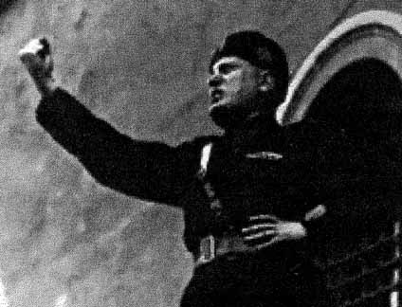
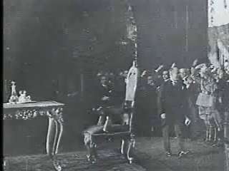
Mussolini as Prime Minister
Watch the video on Mussolini and answer the questions below
Mussolini giving a fiery speech from a Rome balcony
How does Mussolini portray himself in public? What image does he want to public to have of him?
Why do you think strength is so important to Mussolini?
Why does Mussolini relate everything to a battle?

Slide 9
Accomplishments of Fascist Italy 1925-1939
Reduced unemployment
Increased the size of the Italian Armed forces
Built highways
Drained Swamps
Invaded Ethiopia
MADE ITALY STRONG AGAIN

Slide 10
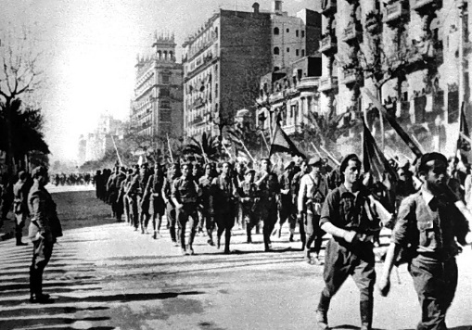
What is Italian Fascism?
The rebuilding of the glory that was Rome
Providing jobs for Italian workers
Keeping Italian capitalists wealthy
Making Italy strong!
OR?

Slide 11
A way to make Mussolini powerful?

Slide 12
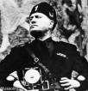
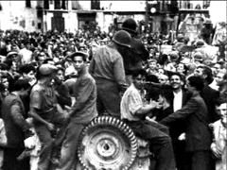
Does Fascism help the leader, the nation or the people?

