Slide 1
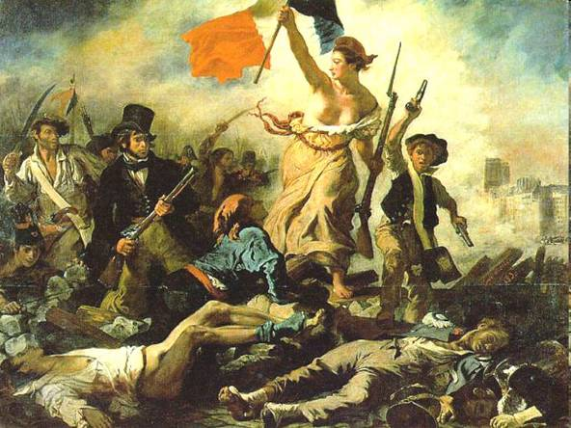
Timeline of the French Revolution

Slide 2
1774
Louis XVI takes the throne at the age of 19.
Well Intentioned but weak leader who was often dominated by his wife, Marie Antoinette.

Slide 3
1789 June
Louis XVI’s government about to go bankrupt calls Estates General.
June 20th, The Tennis Court Oath
The National assembly is formed.

Slide 4
1789 July 14th
The people of Paris storm the Bastille, a much hated prison that symbolized autocratic rule.
The French Revolution had begun.

Slide 5
1789 August
National Assembly adopted the Declaration of the Rights of Man and of the Citizen. Guaranteed the rights of “liberty, property, security, and resistance to oppression” to all people.

Slide 6
1789 October
Peasants rioted. Stormed Versailles and demanded that Louis and Marie Antoinette come to Paris.

Slide 7
1789 October
The Great Fear, Peasants were fearful that the nobles were hiring outlaws to terrorize them.

Slide 8
1791
National Assembly disbanded so the new Legislative Assembly can take over.
Creates a constitutional monarchy; strips power from the king and gave the Assembly the power to create French law.

Slide 9
1791 December
The Revolution leaders start to turn on each other and three factions in the Legislative Assembly form. Radicals, Moderates, and Conservatives

Slide 10
1792 August
20,000 Parisians invade the Royal Palace, Louis, Marie Antoinette and their children Imprisoned.

Slide 11
1792 August
20,000 Parisians invade the Royal Palace, Louis, Marie Antoinette and their children Imprisoned.

Slide 12
1792 December
Louis is no longer king, the radical Jacobins tried Louis for treason and found him guilty. He is sentenced to death.

Slide 13
1793 January
Louis XVI executed by the guillotine.

Slide 14
1793
Maximilien Robespierre becomes the leader of the Committee of Public Safety. He decides who should be considered an enemy of the republic. The committee had people tried and executed in the same day.
Governed France nearly as a dictator, this period became known as the Reign of Terror.

Slide 15
1793 October
Marie Antoinette executed.
Revolutionary courts declare death sentences on those that challenge Robespierre.

Slide 16
1794 July
The National Committee turns on Robespierre, claiming that he is a Tyrant.
He is executed on July 28.
End of the Great Terror

Slide 17
1795
Moderate leaders in the National Convention draft a new Constitution.
It creates a two house legislature and an executive body of five men, known as the Directory.
Napoleon Bonaparte chosen to lead France’s armies.

Slide 18
1799
Napoleon Staged a coup d’etat
Overthrew French Republic

Slide 19
1800
Napoleon made consul of France
New Constitution
As ruler, Napoleon allows changes made during the Revolution to stay as they are.
Napoleon supports laws that give more power to the government.

Slide 20
1804
Napoleon makes himself emperor.
Napoleon becomes more powerful than the Catholic Church.
Napoleon has more power than the original French kings, like Louis XVI.

