Slide 1
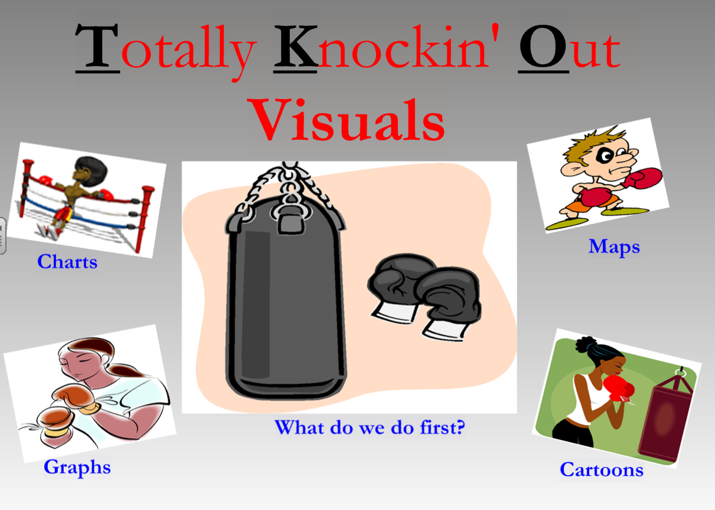
TKO Review
Unit 1 – Social Studies Skills

Slide 2
T – Title / Source Line K- Key Words O- Other Information

Slide 3
Three World Map Projections Mercator, Peters, and Robinson
Using the Text book Review Parts of a Map
Page XXXV I
Notes:
Copyright © 1999 Peter H. Dana, Department of Geography, University of Texas at Austin, 1995. The Geographer's Craft Project, Department of Geography, The University of Colorado. Http://www.colorado.edu/geography/gcraft/notes/mapproj/mapproj_f.html
.

Slide 4
Map
T – Title
Source Line / Geographic Locator
K- Key Words
Captions
O- Other Information
Legend – explains colors symbols lines
Scale – Maps proportions

Slide 5
Political Maps
Political maps show how humans have impacted the landscape. For example, city names, roads, country borders, etc. are all part of political maps.
Wars and ethnic conflict are two major causes political maps change.
Page S20

Slide 6
Thematic Maps
Gives the reader information about certain subjects/ themes.
ALWAYS have a legend that explains the information.
Title of the map tells you what subject you are learning about
Page S22

Slide 7
Independent Practice
1. A map that shows the population of a place is what kind of map?
2. If you looked on a map and saw state capitals, cities and state lines, what kind of map would you be looking at?

Slide 8
Charts
Page S14 - S18
T – Title
Source Line / Rows / Columns / Axis
K- Key Words
Identify the reliability and broad subject
O- Other Information
Scale – graphs proportions
Legends - representations

Slide 9
Primary Source
Page S8
T – Title
Source Line Document and Author
K- Key Words
Identify the Historical Context
O- Other Information
Ellipses … to distinguish if pieces of the text are missing

Slide 10
Primary Source
Page S8
C. O. R. N. P. E. G.

Slide 11
Secondary Source
Page S10
T – Title
Source Line Document and Author
K- Key Words
Bold Headings
Citations
O- Other Information
Dating terms for sequence of events

Slide 12
Political Cartoon
Page S12
T – Title
Source Line Document and Author
K- Key Words
Bold Headings
Captions
O- Other Information
Symbols and characters / POV

Slide 13
Time Line
Page S24
T – Title
Source Line / Dates
K- Key Words
Bold Headings
Chronological Terms
O- Other Information
Images / Symbols / Legends

