Slide 1
World History
Fall Review

Slide 2
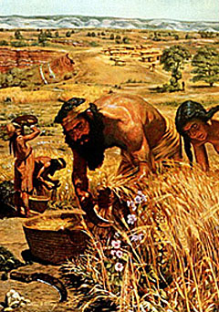
Neolithic Revolution
CAUSES
Hunter-gathering bands scattered seeds near campsites that resulted in growth of new crops
Climate Change – rising temperatures led to longer growing seasons and drier land
Growing populations led to discovery of new food resources and steady source of food
EFFECTS
Shift from food-gathering to food producing cultures leads to establishment of permanent settlements and first cities.
Positive Effects- development of culture including art, religion, and specialization of labor, irrigation systems developed as crop production and land use increase
Negative effects – close proximity of people leads to spread of disease; villages and cities susceptible to attacks; settlements could be destroyed by natural disasters
When people learned how to plant and grow crops, and herd animals
1A

Slide 3
Impact/Influence of Farming on River Valley Civilizations
Development of Agriculture (Neolithic Revolution)
Irrigation leads to development of social classes and organized religion
Features of Civilization
Advanced Cities
Specialized Workers
Government, Religion, Economics
Record Keeping
Advanced Technology (potter, metalwork, beginning of Bronze Age in Sumer in 3000 B.C.

Slide 4
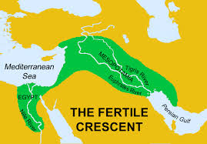
Mesopotamia/Fertile Crescent
Tigris and Euphrates River
Settlement on the Tigris Development of river valley civilizations
and Euphrates Rivers
around 4500BC
Sumerians arrive in
3500 BC and begin irrigation
Sumerian city-states
established around
3000 BC and initially
controlled by temple
priests
Polytheistic religion-
Ziggurat (temple) center
of each city-state
Scientific achievements – wheel, sail, plow, bronze, cuneiform
Babylonian Empire reaches its peak under Hammurabi who established a written, uniform, code of laws (Hammurabi’s Code)
Babylonian Empire ends around 1500 BC and other civilizations in this area, Assyrians, Phoenicians, and Hebrews, adopt ideas first developed by early Sumerians.

Slide 5
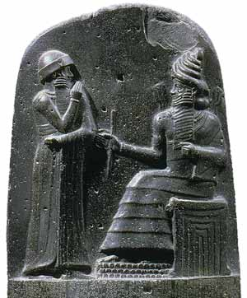
Hammurabi’s Code
Earliest written law code of the Babylonians – promoted justice, but treated social classes differently

Slide 6
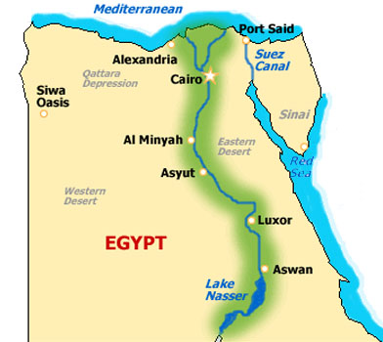
Egypt
3000 BC – 2000 BC
Nile River
Earliest settlement
along the Nile River
begins in 5000 BC
Irrigation along the Nile leads to Egypt
being known as
“The Gift of the Nile”.
Flooding was on a
regular yearly cycle.
Ruled by pharaohs who were considered god-kings;theocracy established as form of government
Polytheistic religion
Scientific achievements – written numbers, geometry, stone columns, calendar for flooding cycle, advanced medicine
Development of river valley civilizations
Religious features –
pyramids built as tombs for pharaohs; belief in the afterlife; mummification of the dead to prevent bodies from decaying
Society – royal family followed by upper class followed by middle class (merchants and artisans) and then the lower class
(peasant farmers and unskilled laborers); slavery later became a source of labor
Writing system- hieroglyphics
Empire declines as other civilizations invade Egypt after 1200 BC

Slide 7
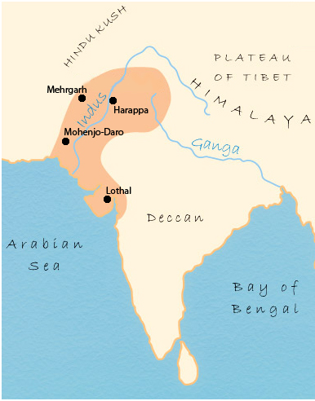
Indus River Valley Civilizations
2500 BC – 1700 BC
Indus River
These early cities decline around 1750 BC due to the possible change in course by the Indus River
Indo-European people known as Aryans settle in the Indus Valley around 1500 BC
Caste system develops under Aryans
First major cities include Mohenjo-Daro and Harappa that were developed on grid systems and had sophisticated plumbing and sewage systems
Early cities decline around 1750 BC due to possible change in course by the Indus River
Development of River Valley
Civilizations

Slide 8
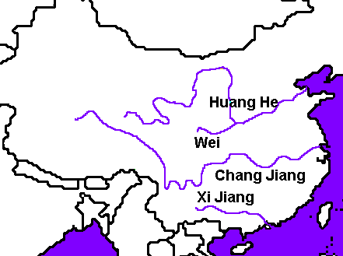
Chinese River Valley Civilizations
3950 BC – 1000 BC
Huang He (Yellow) River Valley

Slide 9
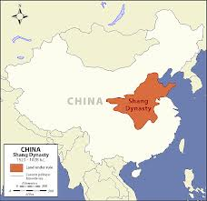
SHANG DYNASTY
Development of River Valley
Civilizations
Division of classes
Importance of family
Writing system where each symbol represents an idea
Technology and science – bronze working, silk

Slide 10
How Major River Valley Civilizations Influenced Classical Civilizations
Lay the foundations for political centralization and organization
Monument building
Written articulation of legal codes
Social classes

Slide 11
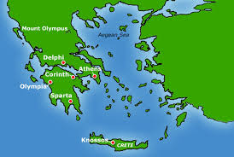
Geography Shapes Greek Life
Rugged mountains divide land into different regions
Difficult to unite Greeks under one, single government
Developed into small, independent communities

Slide 12
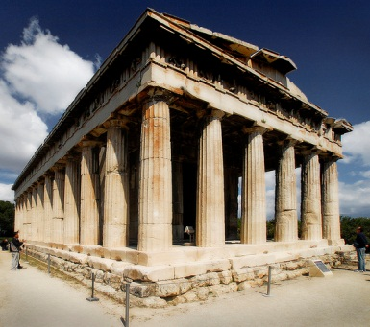
Greek Civilization
Development of Classical Civilizations
Establishment of the early Greek city-state (polis)
Political structures include monarchy, aristocracy, oligarchy, and democracy
Limited democracy in Athens
The Persian Wars (490 BC – 479 BC)
Effects of Persian War – new confidence and freedom from for Greek city-states; Athens begins golden age and becomes leader of 140 city-state Delian League
Pericles and Democracy in Athens leads to a golden age-establishment of direct democracy; strengthening of navy and overseas trade; wealth used to create great works, including Parthenon
Development of Greek art- classical art that addresses order, balance, and proportion (RENAISSANCE)
Greek drama, Growth of philosophy (Englightenment)
Empire under Alexander the Great (336 BC – 323 BC)
Inherits throne of Macedonia; conquers Greece, Babylon, Persia, and Egypt; boundaries extend east to India
Conquests bring about end of independent Greek city-states and blend Greek cultures with eastern cultures to establish the Hellenistic Age
Hellenistic Era brings about advancements in trade, astronomy, mathematics, philosophy, and art; Alexandria in Egypt is center of Hellenistic world, conquered by Rome in 150 BC

Slide 13
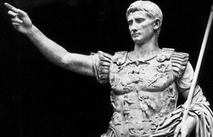
Development of Classical Civilizations
ROME
Political Influence
Executive Powers
Legislative Powers
Judicial Powers
Legal Code- Twelve Tables (Written list of rules based on the Roma Legal System)
Established in 750 BC along Tiber River
Religious and cultural ideas borrowed from Greeks and Etruscans
Roman Republic established in 509 BC; voting rights extended only to free-born male citizens
Roman society divided into patricians (aristocracy) and plebeians (farmers and artisans)

Slide 14
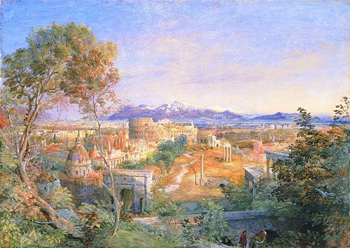
Roman Civilization
Cultural Influences
Borrowed from Classical Greeks: Greco-Roman culture
Literature Greek form, but Roman themes
Latin-official language of Roman Catholic Church
Romance languages
Architecture-Coliseum, arches, domes, concrete
Aqueducts to transport water to urban areas
Roman laws become basis for laws in western world
Religious and Philosophical Influences
Philosophy based on Greek Stoicism
Christianity develops in Roman province of Judea, spreads throughout empire
Nicene Code defines Christian beliefs
Absorbed Greek learning – known for engineering skills, rule of law, and
The Rise of Christianity

Slide 15
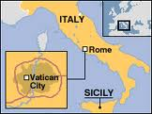
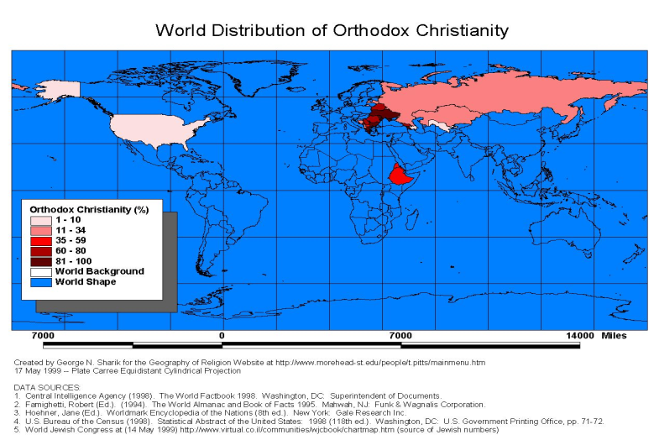
Great Schism of 1054 Divides
Eastern and Western Churches
Roman Catholicism
Eastern Orthodoxy
Patriarch and other bishops lead the church as a collective group
Service conducted in Greek or local languages
Priests may marry
Divorce is allowed under certain circumstances
Pope has authority over all other bishops, kings, and emperors
Services conducted in Latin
Priests cannot marry
Divorce is not permitted

Slide 16
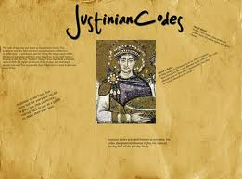
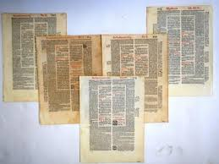
Justinian’s Code of Law
Body of Civil Law , Single, Uniform Code of Law for Byzantine Empire
Influences U.S Laws

Slide 17
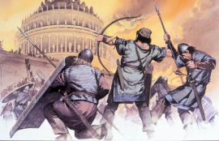
Fall of the Roman Empire
Impact on Western Europe
Disruption of trade leads to collapse of businesses, destruction of economic centers
Shift to a rural population as Roman citizens abandoned destroyed cities
Decline of learning since Germanic invaders could not read or write
Loss of common language as Latin changes
Change in the concept of government from one of loyalty to public government and written law shifts to governance through unwritten laws and traditions
In 476 – Rome was overrun by invading barbarian tribes
Followed by the Dark Ages – a period of great turmoil in Europe

Slide 18
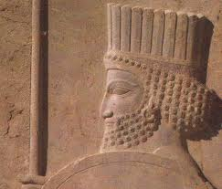
Persia
Development of Classical Civilizations
Persian empire founded by Cyrus the Great
Darius divides the empire into provinces that are parallel to the
homelands of the different people within the empire. These people
live by their own laws within the Persian empire
.Influences
Royal Road connects the empire for over 1,500 miles
Use of standardized metal coins promote trade and unify the empire
Zorastrianism- monotheistic worship; early beliefs in heaven,hell,judgement

Slide 19
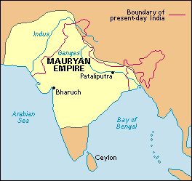
Mauryan Empire
Development of Classical Civilizations
( 302 BC – 232 BC)
Chandragupta and Asoka:
Bureaucracy
Improved roads
Spread of Buddhism

Slide 20
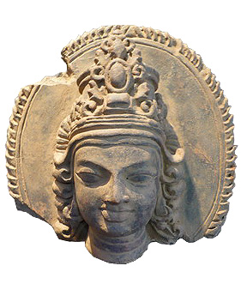
Gupta Empire
300 AD
Development of Classical Civilizations
Chandra Gupta I; India’s Golden Age: Peace, Prosperity
Hindu Beliefs
Art
Literature, Sanskrit
Astronomy
Medicine
Mathematics: Decimals

Slide 21
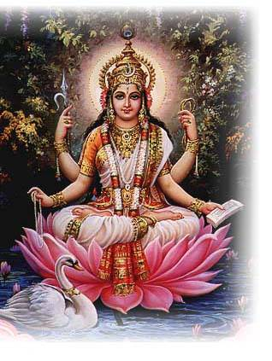
Hinduism
Polytheistic
Reincarnation
Many gods and goddesses
Karma and Dharma
Vedas- collection of hymns and religious ceremonies
Associated primarily with India

Slide 22
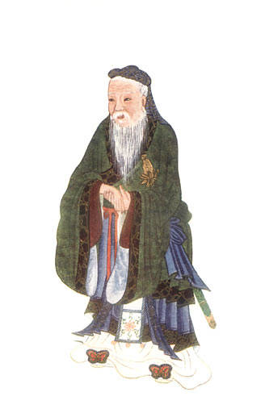
Zhou Dynasty
1027 BC-256 BC
Development of Classical Civilizations
Zhou rulers justified their rule by the Mandate of Heaven –
If a ruler was selfish and ruthless, Heaven would overthrow him. Nobles rule through feudalism
Chinese Philosophies Established Under the Zhou
Confucianism- reform in society including social order of family and government
Daoism- philosophy established by Laozi that addresses order and harmony
Legalism- stressed punishment over rewards

Slide 23
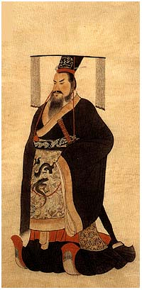
Qin Dynasty
256 BC – 202 BC
Development of Classical Civilizations
Qin Shi Huangdi – China’s first emperor, uses Legalist ideas to unfiy China through autocracy
Unified China, built roads and canals
Constructed the Great Wall to protect the empire
Mass murder of Confucian scholars

Slide 24
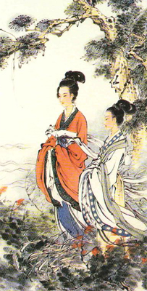
Han Dynasty
202 BC – 9 AD
Development of Classical Civilizations
Silk Road
Centralized Government
Civil service examinations
Invention of Ceramics
Invention of Paper
Beginning of Pax Sinica
Promotion of Confucianism

Slide 25
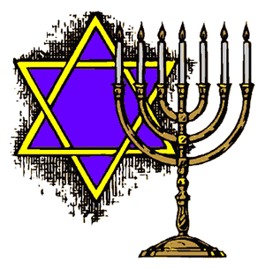
JUDAISM
Israel: Hebrews monotheistic and worship Yahweh
Abraham, Moses, David
Monotheistic
10 Commandments, civil and religious laws
Torah, sacred writings
“Promised Land” in Canaan
Messiah

Slide 26
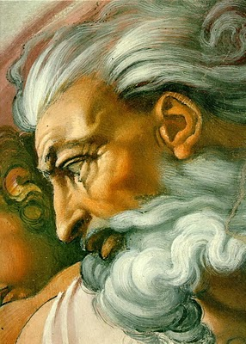
Monotheism
Belief in one God
Shared by Judaism, Christianity and Islam

Slide 27
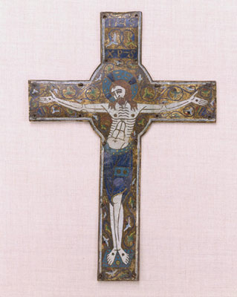
Christianity
Based on teachings of Jesus as the Son of God, rejected by the Jews as messiah, crucified
Forgiveness, Mercy, Sympathy for Poor
Peter, Paul, Pax Romana make the spread of Christianity possible
312 AD, Edict of Milan declares Christianity to be an approved religion by emperor
Church hierarchy established
Rome official center of the Christian Church
Through Middle Ages, the Church becomes the centralizing force of the Western Culture

Slide 28
Turning Points
Spread of Christianity
CAUSE:
Spread of Christianity throughout the Roman empire
Peter, Paul, Pax Romana make spread of Christianity possible
EFFECTS:
Constantine accepts Christianity as the official religion of the Roman Empire
Eastern Orthodoxy develops after the schism between that church and the Catholic Church
Church develops in power during the Middle Ages in Europe

Slide 29
Islam
Founded by Muhammad
Muslims worship Allah
Mecca – Holy City of Islamic Faith
Allah- monotheistic deity
Hajj- pilgrimage to Mecca
Koran (Qur’an) – Holy Book
Jihad- Holy Struggle
Five Pillars of Faith
Share wealth between rich and poor
Trade and spread of religion- Silk roads, European exploration

Slide 30
Islam’s Impact
AFRICA
Arab traders settle in port cities in East Africa
Bantu language blends with Arabic to create Swahili
Introduction of slave trade in Africa
Growth of commerce in East Africa leads to spread of Islam to other parts of the continent
God-Salt Trade between North African Muslims and West Africa Empires leads to spread of Islam
EUROPE
Moors occupy Spain for over 700 years and promote Golden Age in art, literature, science, and mathematics
Defeat by the Franks at Tours in 732 stops the Muslim invasion of Europe
ASIA
Ottomon Empire established in Turkey and lasts until the end of WWI
Mongol invasions of Baghdad
Safavids create a Shi’a empire in Persia
Mughals establish a Muslim empire in India

Slide 31
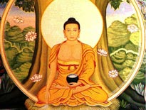
Buddhism
Four Noble Truths and Eightfold Path
Founded by Siddhartha Gautama
Non-Violence, Self-Denial
Oneness with “Great World Soul”
Reject Caste System and Numerous Gods

Slide 32
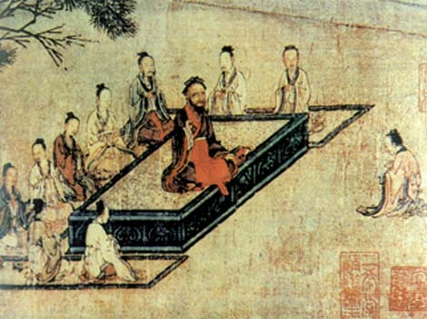
Confucianism
Filial Piety = Respect for elders and order
Right to Rule should be open to all men of talent

Slide 33
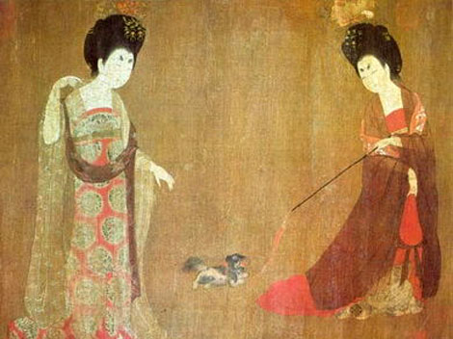
Impact on Eastern Asia
Tang Dynasty
Cultural
Spread of Buddhism through trade networks to Japan, Korea, and to Vietnam
Greater social mobility and movement to cities
Decline in the status of women including the beginning of binding the feet of upper class girls
618 AD – 907 AD
Political
Emperor Taizong extends China’s boundaries north to Manchuria, south to Vietnam, and east to the Aral Sea
Empress Wu Zhao extends Chinese influence to the Korean Peninsula
Scholar- officials take competitive civil service exams to work in the government offices
Economic
Foreign trade on the Silk Road grows
Arrival of tea from Southeast Asia
New inventions-porcelain, mechanical clocks, block printing, gunpowder all increase trade and spread to Japan and Korea

Slide 34
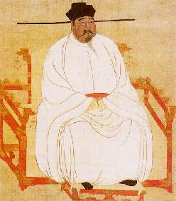
Song Dynasty
Impact on Eastern Asia
Political Developments:
Rule limited to Southern China after Tang losses in Central Asia and Manchuria
Economic Developments:
Introduction of a fast-growing rice from Vietnam that led to faster growing population
Movable type spreads to Japan and Korea
Paper money contributes to a large-scale economy
Advances in sailing technology, such as the magnetic compass, lead to the growth of ocean trade
Cultural Developments:
New height in Chinese art – natural landscapes and objects drawn with black ink
China’s population at 100 million with ten cities having at least 1 million people

Slide 35
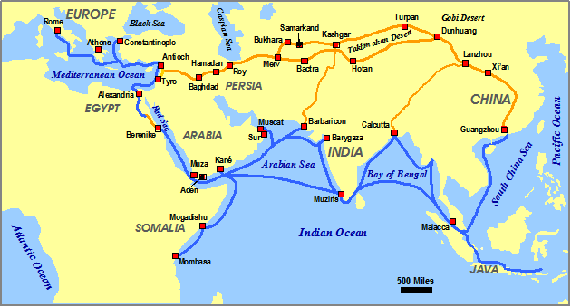
Silk Road
Facilitated Spread of Ideas and Trade
Indian
Traders
Middlemen
Roman ideas taken to Eastern provinces
Spices and Silk transported to West
Promotion of cultural diffusion between regions that come into contact with each other
Trade route connecting China to the Roman Empire.

Slide 36
Turning Points
Mongol Invasions
1C
CAUSE:
13th Century – spread across Eurasia to create on of the world’s largest
Empires
Brutal conquest of Abbasid Empire and Russian principalities
EFFECTS:
“Pax Mongolia” that supported trade along Silk Road
Kublai Khan kept Chinese political and economic systems in place
IMPROVED TRADE AND TRAVEL ALONG SILK ROAD

Slide 37
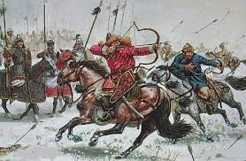
Changes Resulting From Mongol Invasions of Russia, China, and Islamic World
Russia
Fall of Kiev (1240)
Religion and culture permitted to continue as long as high tributes paid
Isolation from Western Europe prevents spread of new ideas and inventions
Moscow emerges as a major city
Ivan III assumes the title of czar and achieves a bloodless standoff at the Ugra River that leads to separation from the Mongols
China
Northern China conquered by Ogadi (Genghis Khan’s son) in 1234
Kublai Khan, completes the capture of southern China
China united for the first time in 300 years
Mongol control over Asia opens China to foreign contacts and trade (Marco Polo)
Islamic World
Hulagu ( grandson of Genghis Khan) captures Baghdad and has over 10,000 people killed
End of Seljuk Turkish rule after the capture of the Sultanate of Rum in Anatolia
Poor administration of captured regions leads to dissolution of Mongol empires and rise of the Ottoman Turks

Slide 38
Turning Points
Development of Islamic Caliphates
1C
CAUSE:
Abbasid Caliphate – Baghdad
Fatimid Caliphate – Cairo
Umayyad Caliphate - Damascus
Golden Age
Astronomy, Medicine, Chemistry, Mathematics
( This knowledge will be transported to Europe during the Crusades)

Slide 39
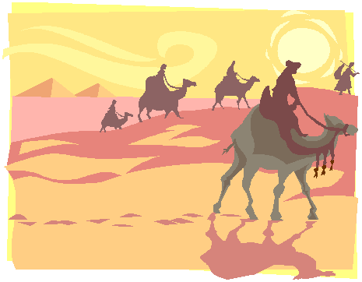
African Salt/Gold Trade
Expansion of Islam into North Africa
Facilitated Spread of Ideas and Trade
Arab and Berber traders took salt from the Sahara to West Africa in exchange for gold
African traders also crossed the Sahara to trade for salt in North Arica
Cloth and weapons from Mediterranean ports taken to West Africa
Powerful rulers in Ghana and Mali regulated the gold trade in West Africa
Sahara Desert merchant caravans exchanged salt for gold
EXAMPLE OF CULTURAL DIFFUSION

Slide 40
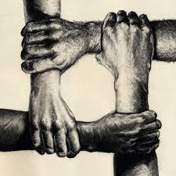
Christianity Unifies
Byzantine Empire:
Constantine relocates capital of Eastern Roman Empire to Byzantium and renames it Constantinople
Justinian constructs the Hagia Sophia, close connection between church and state
Medieval Europe:
Missionaries spread Christianity
Authority in medieval Europe based on the Church
Charlemagne crowned emperor by Pope Leo III, which shows the close connection between church and state
Shared Christian beliefs bond people of Europe together
Church provides stability and security in times of frequent wars
Middle Ages seen as the “Age of Faith”
Church creates a system of justice (canon law) to regulate conduct

Slide 41
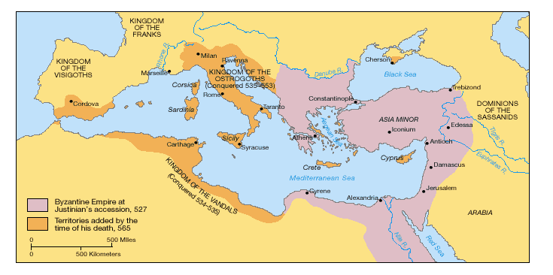
Byzantine Empire
Eastern Roman Empire - Constantinople

Slide 42
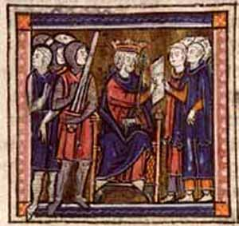
Justinian’s Code of Laws
In Byzantium, Justinian collected all Roman laws and organized them into a single code

Slide 43
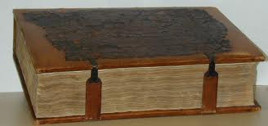
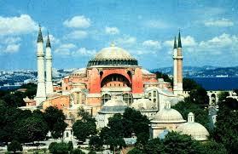
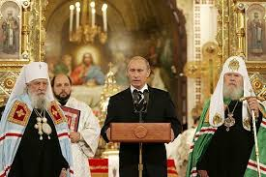
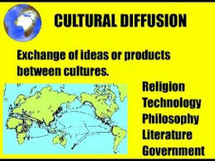
Byzantine Empire Influences
Code of Law
Hagia Sophia Cathedral
Missionaries spread Eastern Orthodox Religion in Russia

Slide 44
Turning Points
Decline of Rome and Formation of Medieval Europe
1C
CAUSE:
Invaders overrun the empire (Mongols, Huns, Franks, etc.)
Inflation
Roman army cannot defend the empire
EFFECTS:
People’s loyalty and service to the empire declines
Roman politics decay- empire is split; an additional capital is established (Constantinople), but this does not save it
People turn to the Church and lords for security and protection
Development of feudalism and strong Church authority in medieval Europe

Slide 45
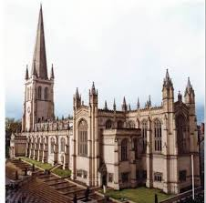
Role of the Church in Medieval Europe
Clergy
Canon Law
Sacraments
Excommunication
Religion a Unifying Force

Slide 46
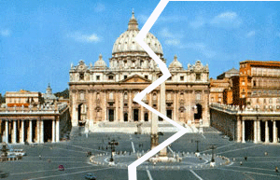
Great Schism
Split in Catholic Church with two Popes
Caused many to question the authority of The Church
Split in Catholic Church as two popes claim authority; both excommunicate each other from the Church
Authority of the Pope as the head of the Church challenged by John Wycliffe, who believes that God is sole authority, and Jan Huss, who believes the authority of the Bible is higher than the pope’s authority; beginning of challenges to the authority of the Catholic Church that leads to the Reformation

Slide 47
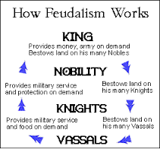
Feudalism

Slide 48
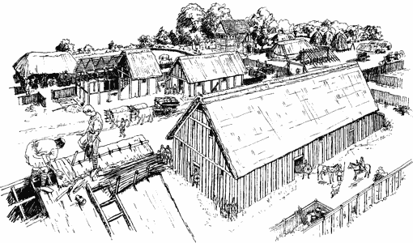
Manorialism
Economic system of feudal Europe – self-sufficient manors

Slide 49
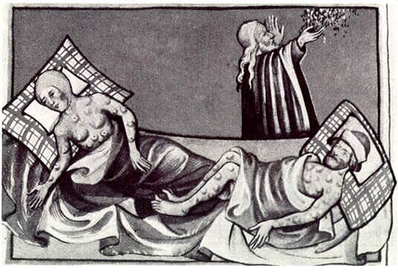
Black Death
Disease carried by fleas on rats that killed millions of people in Europe
Collapse of manorial system as productivity ends and serfs leave in search of work; peasant rebellions grow in response to nobles’ refusal to increase wages, economic decline
Church loses prestige as it is unable to stop the plague through prayer and intervention

Slide 50
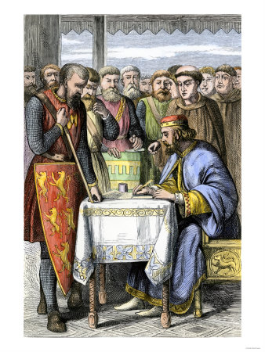
Magna Carta
In 1215, King John of England guaranteed right to a trial by jury and consent of a council of nobles needed for any new taxes.
Created Limited Government and Parliament

Slide 51
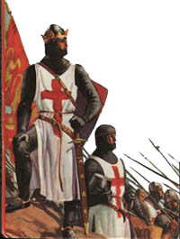
Crusades
Goal: recapture the Holy Land from Muslims – Led to increased trade between Europe and the Middle East and the downfall of medieval Europe
Failure lessened the power of the Pope
Casualties weakened the feudal nobility
Trade in spices and other goods from Southwest Asia lead to European desire for new trade routes that begins the Era of Exploration

Slide 52
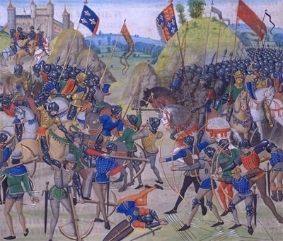
Hundred Years’ War
War between England and France over succession to the French throne
Knights no longer important/ Long Bow successful
Brought an end to feudalism
Emergence of nationalism and monarchs as national leaders in England and France
Instability in England after the Hundred Years War leads to War of the Roses, strengthens Parliament since it is called frequently by King Edward III to increase taxes to finance this new war; democracy advanced as Parliament gains greater “power of the purse”

Slide 53
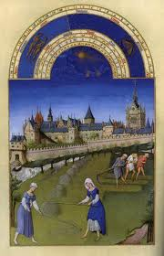
The End of Medieval Europe
Crusades
Black Death
Hundred Years War
Great Schism

